Slide 1


Slide 2


Agenda
What can we do for you?
Data Governance
Catalogue & Lineage
Data Quality
Security
Advisory
As-Is
Way Forward

Slide 3








Data Driven Business
Data Governance seeks alignment with a Data Driven AI Organization (Data culture + Technology) strategy, where data is a strategic asset.
It is based on the following pillars:
Data Governance
Organisation
Lineage and Catalogue
Quality
Master Data
Security
Architecture
Notes:
Mejorar la diagramación

Slide 4
Data Governance
Data Governance seeks alignment with a Data Driven AI Organization (Data culture + Technology) strategy, where data is a strategic asset.
It is based on the following pillars:
Structure and leadership for data management. Organisational models, committees and key guidelines. Combines effective communication.
Organisation
Guarantees key data (customers, products, employees, etc.). Applies consolidation and normalisation rules to achieve a reliable and unified view of information.
It ensures accurate, complete and always up-to-date data. It establishes business rules and general rules.
Lineage and Catalogue
Quality
Master Data
Protects information through encryption, controls, and compliance. Role- and attribute-based access rules and levels are set.
Security
Discovery of the origin and path of data with full transparency. Centralise catalogues, glossaries, and metadata management.
Architecture
Organise, integrate, and align data efficiently. It employs governance, monitoring, and exploitation tools to maximise the value of information.

Slide 5
Data Governance
Data Governance seeks alignment with a Data Driven AI Organization (Data culture + Technology) strategy, where data is a strategic asset.
It is based on the following pillars:
Structure and leadership for data management. Organisational models, committees and key guidelines. Combines effective communication.
Organisation
Guarantees key data (customers, products, employees, etc.). Applies consolidation and normalisation rules to achieve a reliable and unified view of information.
It ensures accurate, complete and always up-to-date data. It establishes business rules and general rules.
Lineage and Catalogue
Quality
Master Data
Protects information through encryption, controls, and compliance. Role- and attribute-based access rules and levels are set.
Security
Discovery of the origin and path of data with full transparency. Centralise catalogues, glossaries, and metadata management.
Architecture
Organise, integrate, and align data efficiently. It employs governance, monitoring, and exploitation tools to maximise the value of information.

Slide 6

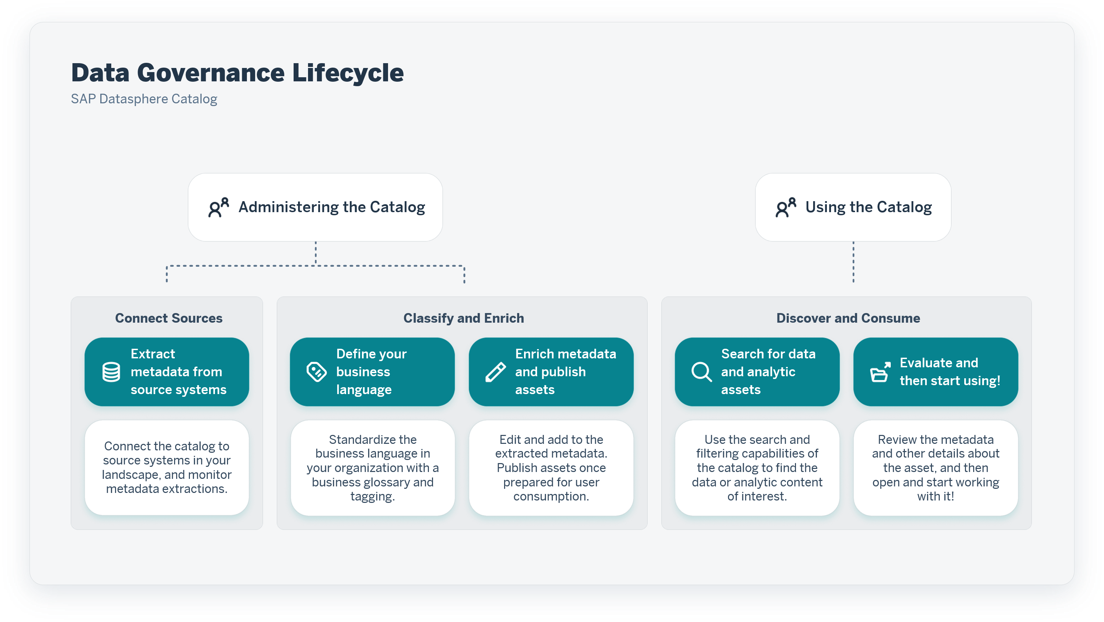
Datasphere Catalog

Slide 7
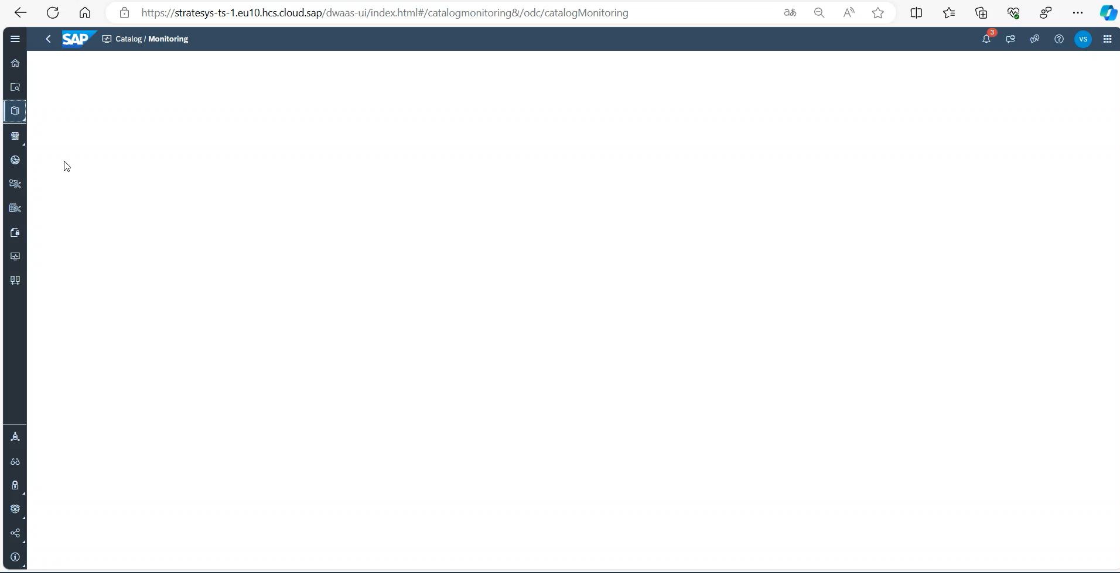
Datasphere Catalog
Catalog & Lineage

Slide 8
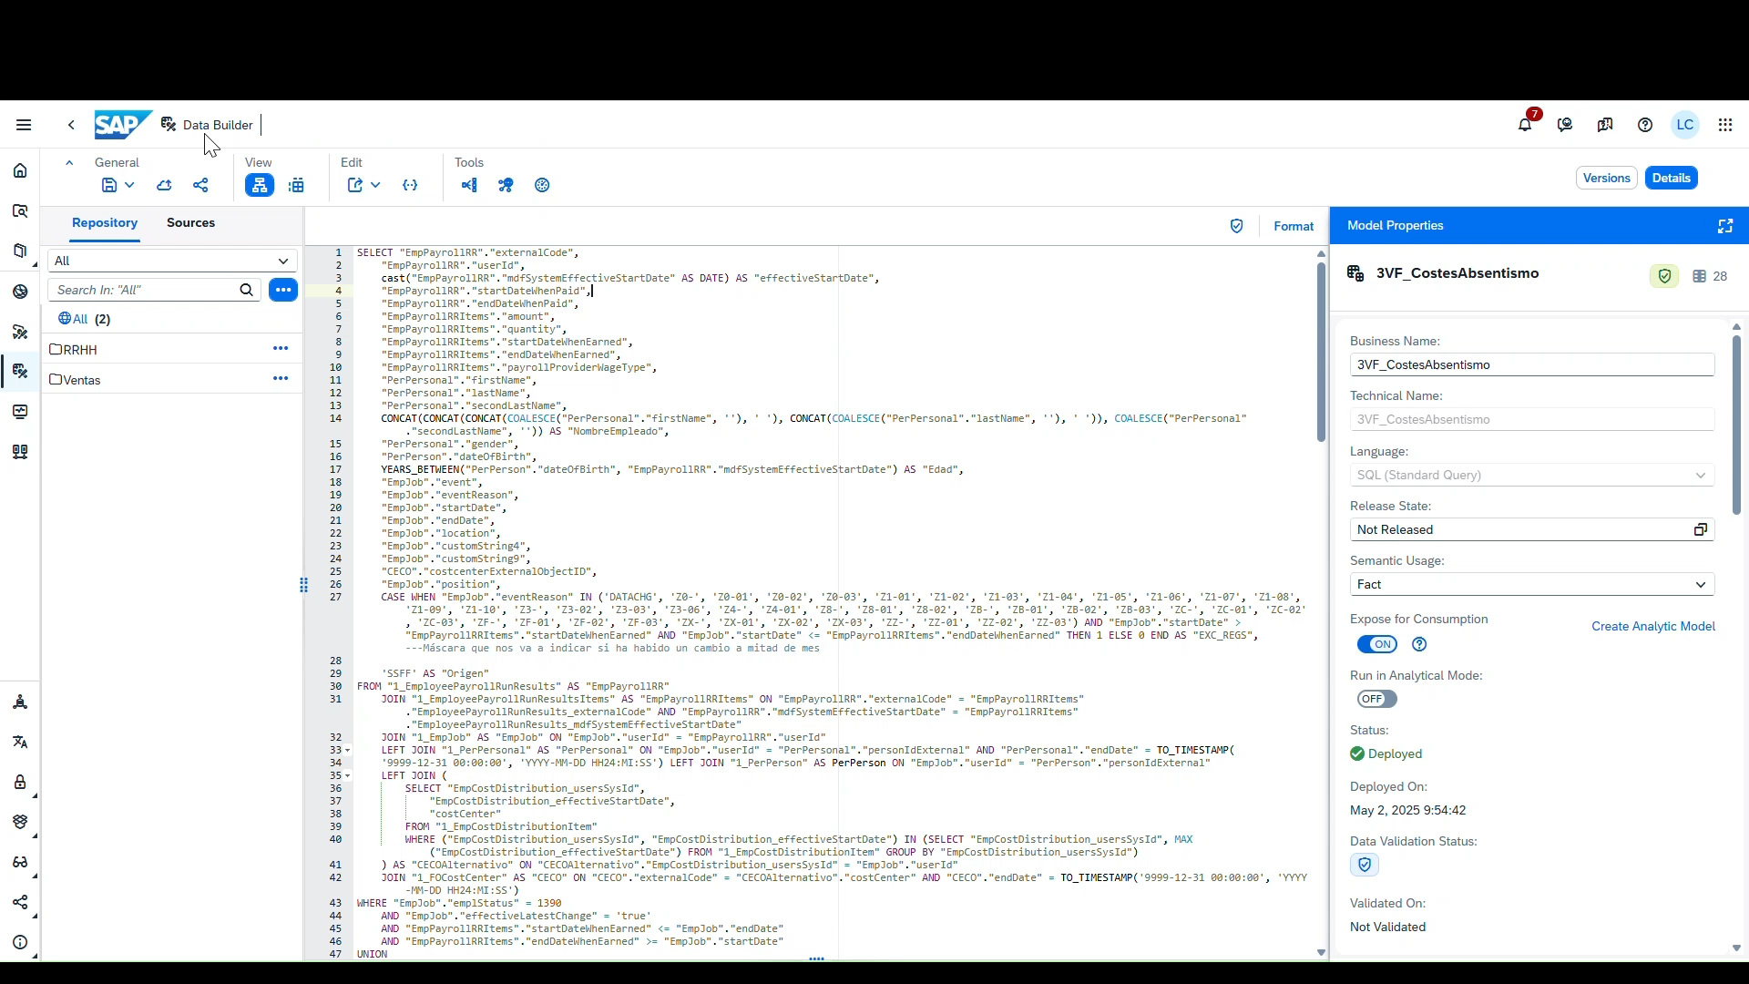
Datasphere Catalog
Lineage

Slide 9
Datasphere Catalog

Slide 10

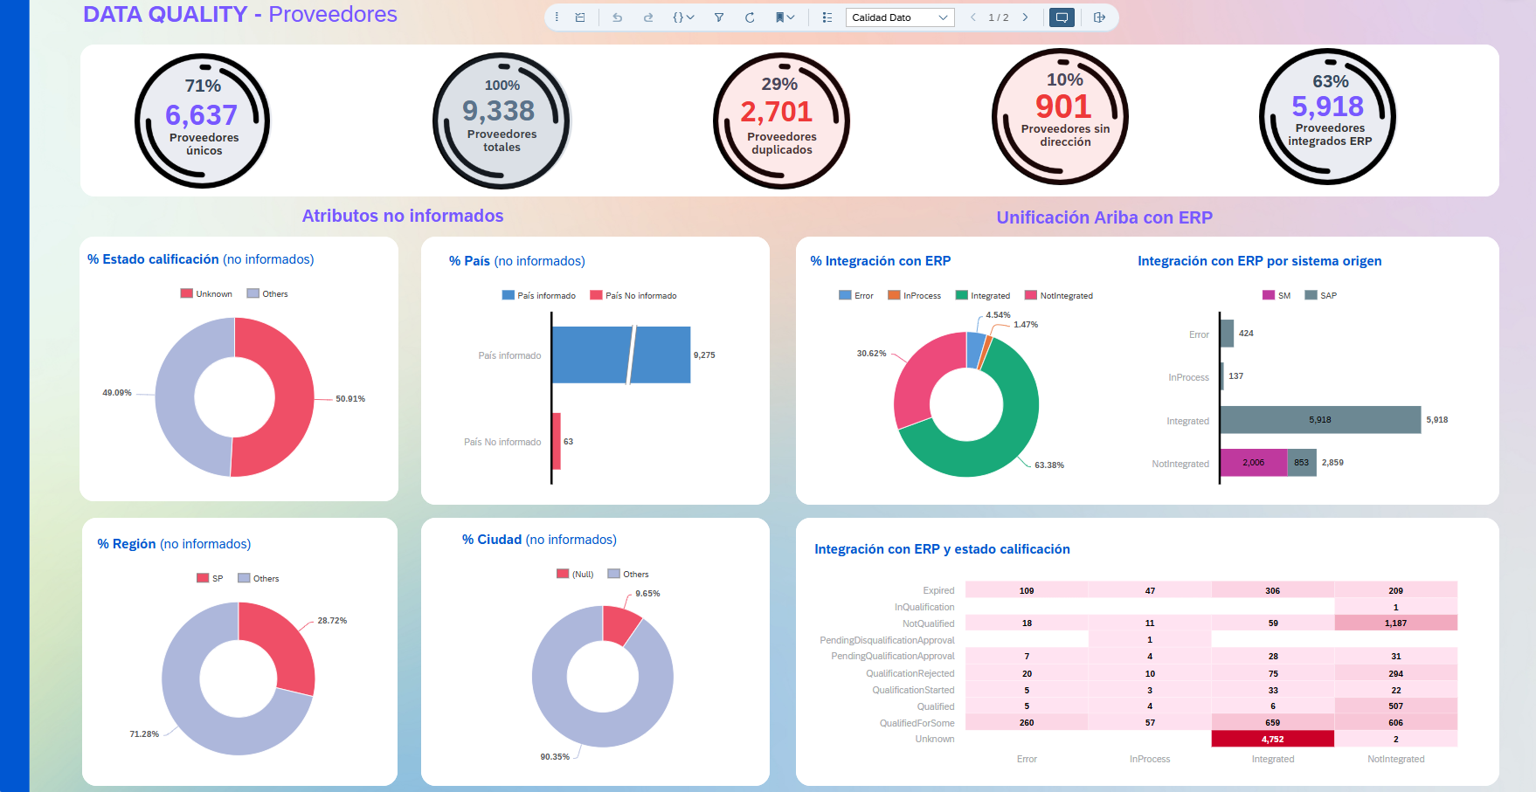
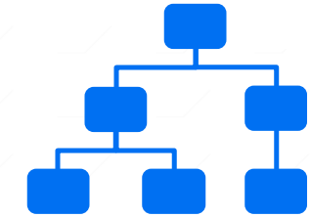
Datasphere Data Quality
2nd Phase
Definition of corrective actions and remediation plans
1st Phase
Data Health
(Monitoring)
3rd Phase
Implementation
1. Format correction and adaptation
HANA SQL, SQLScript, and Python have hundreds of formatting and syntax adaptation functions that allow you to automatically correct typos and enrich data using custom logic.
2. Data error detection and alerting
Using SAP Analytics Cloud, you can create alerts associated with data that allow you to automate the detection and notification of errors graphically or by e-mail.
3. Correction in external systems
Through direct integration of SAP Datasphere with external systems with ODATA or replication flow, correction of data at transactional source is possible. (External system must be supported)
DATA QUALITY DASHBOARD
- Identification of duplications - Master data grouping - Field cleanup and exclusion filters - Enrichment with the generation of additional fields, groupings or rankings.

Slide 11
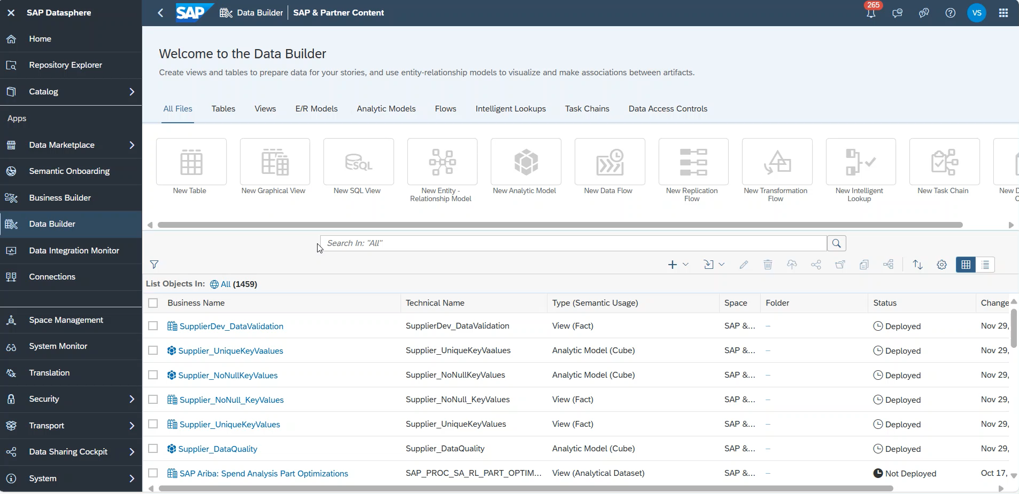
Datasphere Data Quality
Notes:
Supplier DataQuality - Stories - SAP Analytics Cloud

Slide 12
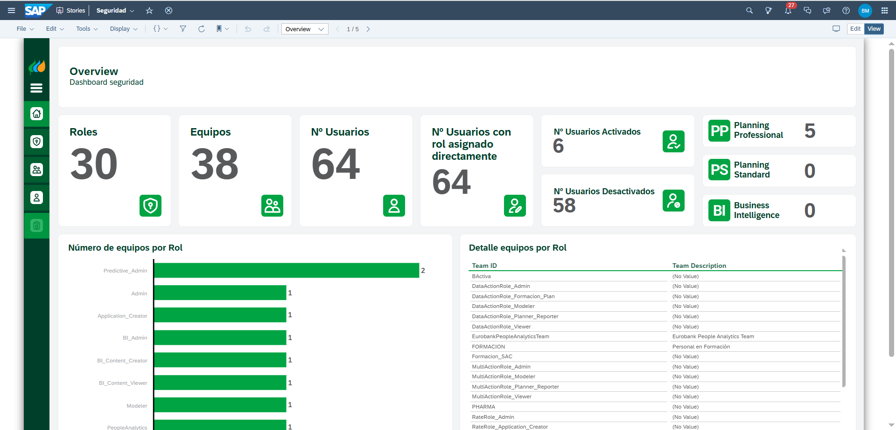
Security
Admin Monitor
https://stratesys-ts.eu10.hcs.cloud.sap/sap/fpa/ui/tenants/6bdd2/bo/story/8A8032065263163B58BDCEE7CB7C1A84
Notes:
🔐 Seguridad: Tres productos clave
1. Gestión de Accesos (Access Management)
Capacidad para definir, asignar y gestionar derechos de acceso mediante modelos RBAC y ABAC:
Asignación dinámica de permisos según rol, función o atributos (hora, ubicación, sensibilidad del dato...).
Interoperabilidad con herramientas de identidad y single sign-on (SSO).
Trazabilidad de accesos y decisiones de autorización.
🎯 Objetivo: Garantizar el acceso correcto al dato correcto por el perfil correcto, minimizando el riesgo operativo y habilitando el autoservicio seguro.
2. Controles de Uso y Consumo (Consumption & Usage Controls)
Supervisión y restricción del uso de datos y herramientas:
Políticas sobre lectura, modificación, exportación, combinación o persistencia de datos.
Límites de frecuencia o volumen de consumo (rate limiting, quota, etc.).
Auditoría de eventos y comportamiento inusual (ej. consultas masivas o fuera de horario).
🎯 Objetivo: Asegurar un uso responsable y eficiente del dato sin fricciones para los usuarios.
3. Apoyo al Cumplimiento Normativo (Compliance Support)
Automatización de requisitos regulatorios sin comprometer la agilidad:
Eliminación programada o anonimización de datos personales (ej. RGPD, CCPA).
Registro y justificación del ciclo de vida del dato (data retention policies).
Evidencias de acceso, tratamiento y eliminación ante auditorías.
🎯 Objetivo: Facilitar el cumplimiento normativo desde la arquitectura, con bajo impacto operativo.

Slide 13








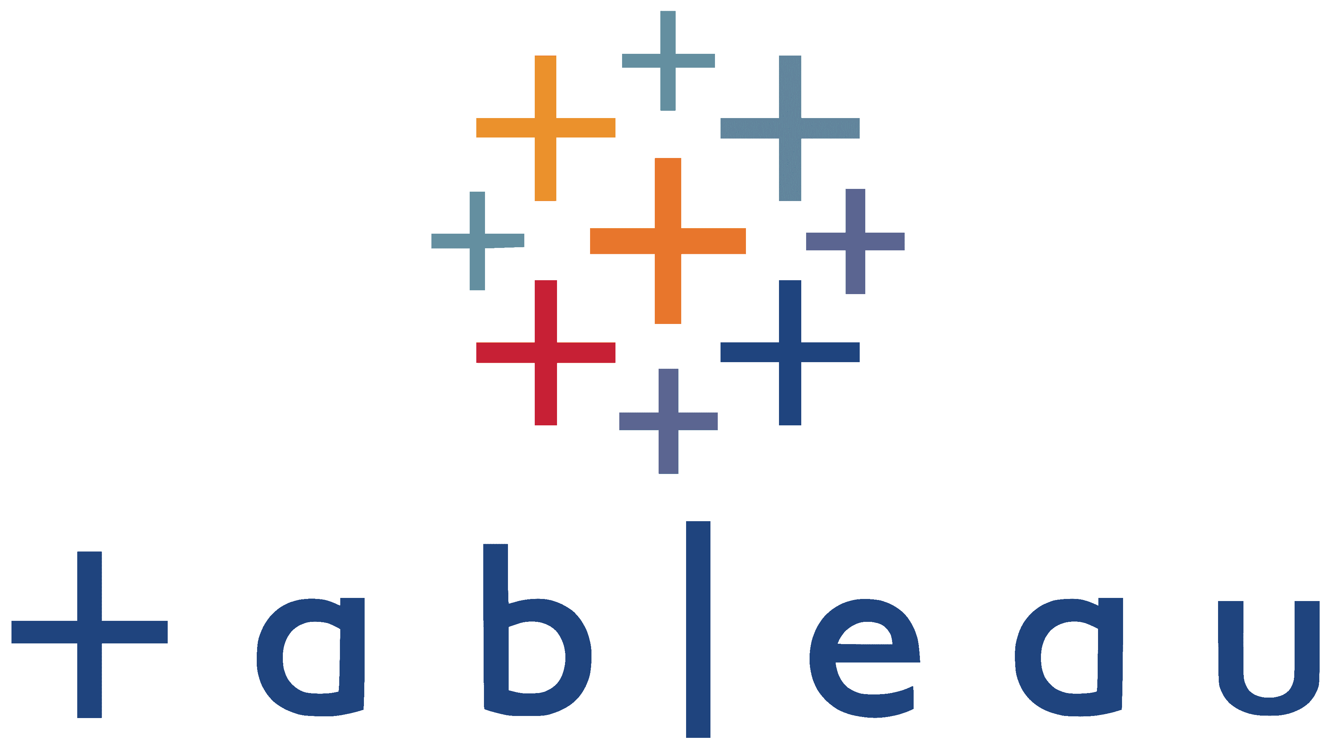







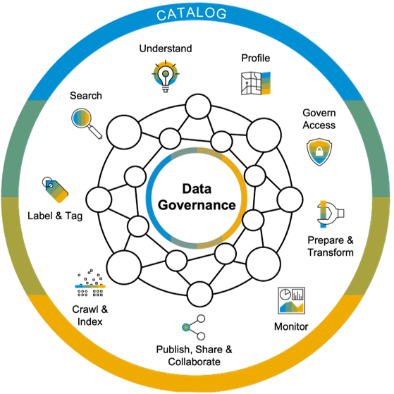
+
Essential for collaboration and democratization of data. It enables users to discover, understand, and prepare business data. Improve productivity by building trust in metadata through consistent data quality and governance. Users can search and filter data, view asset lineage and details, enrich and classify assets, and share them with other users.
Discover
Discover data (Track, profile, organize, link, and enrich) and create accessible data (browse, search)
Organize
Sort, organize, and understand data
(location, attributes, quality, lineage, sensitivity)
SAP Analytics Cloud*
SAP Datasphere**
Control
Apply centralized authorization and security for orchestration and control of data quality standards
Metadata
Data Lineage
Glossary
Classification
SAP BW4/HANA**
SAP ECC*
Cloud applications
SAP HANA Cloud**
On-premise sources
SAP S/4HANA**
Non-SAP data landscape
SAP data landscape

Slide 14
Data Governance
Actionables
1. Catalogue & Lineage
2. Data Quality
Review one (1) dataflow with up to ten (10) associated tables, ensuring alignment with architecture, naming conventions, and best practices.
2 - 4 weeks
Configure the Data Quality Rules available for the assets of one (1) business area and up to ten (10) unique assets with up to ten (10) rules per asset. Also, plug-in the Data Quality Monitor.
4 - 5 weeks
3. Security
4. Collibra
Configure “Admin Monitor” for SAC and Datasphere.
1 - 3 weeks
Integrate Datasphere to Collibra.
3 - 5 weeks

Slide 15

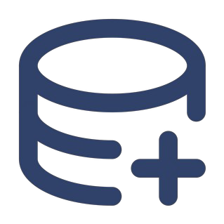








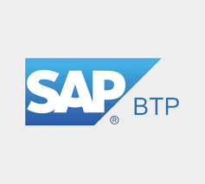


Access Automation
System Design Overview
Chatbot User request
Approval Workflow activation
Approval process completion
System access provision
User Notification
Access Allowed
Microsoft Teams using Auth2 connection
LLM Agentic Layer
SAP Workflow Management
Access to SAC or datasphere leveraging SAP Integration Suite API Management
Microsoft Teams using Auth2 connection
SAP/Datasphere access
Notes:
2.1 Identidad y seguridad
IAS + Azure AD: tutorial oficial de federación SAML/OIDC.
IPS: drivers SCIM para Datasphere listos out-of-the-box.
XSUAA: gestiona scopes/roles para microservicios CAP o Node.
2.2 Front-end
Build Work Zone AE ↔ Teams: integración guiada en la consola.
Build Apps: ejemplos de tarjetas adaptativas disparadas desde Build Apps a Teams.
2.3 Automatización
SAP Build Process Automation: APIs REST/Events + Task Center.
2.4 Integración
Cloud Integration consume APIs OData de Datasphere con OAuth2.
API Management para exponer SCIM/audit; buenas prácticas en KBA.
Advanced Event Mesh: backbone asíncrono para “AccessApproved”.
2.5 Datos
Datasphere + SCIM confirmado; grupos aún en roadmap.
HANA Cloud (logs): opcional, no hay incompatibilidades.
2.6 Gobierno & Ops
Cloud ALM cubre iFlows y workflows; vista Integration & Exception Monitoring.
Alert Notification → Teams vía webhook nativo.
Transport Management Service integrable con GitHub Actions para CI/CD.

Slide 16
Access Automation
Actionable
1. App
Build PoC App for 10 users and 1 approver.
1 Data Model/Dashboard
7 - 9 Weeks

Slide 17
Advisory
Best Practices Datasphere
A comprehensive review of SAP Datasphere developments and documentation to ensure alignment with best practices, standards, and project goals, covering both completed and ongoing workstreams:
Documentation Review
Why and What:
Guarantees quality and alignment with actual developments.
Functional & technical designs.
Test documents and KPIs.
Reconciliation guides, GAPS, lessons learned.
Best Practices & Compliance
Why and What:
Ensures developments meet standards and security.
Roles & authorizations.
Technical names validation across the system.
Versioning, security, governance.
SAP Datasphere Advisory
Ensuring quality, compliance, risks and best practices in all developments (completed and ongoing).
Developments Review
Why and What:
Ensures correct use of spaces and object structures.
Queries, models, dataflows.
Use of spaces and consistency checks.
Architecture Review
Why and What:
Ensures a clear definition of architecture and responsibilities.
Guarantees that developments are done in the right place (where they belong).
Clear guidelines on “where to do what”
Compliance with best practices

Slide 18

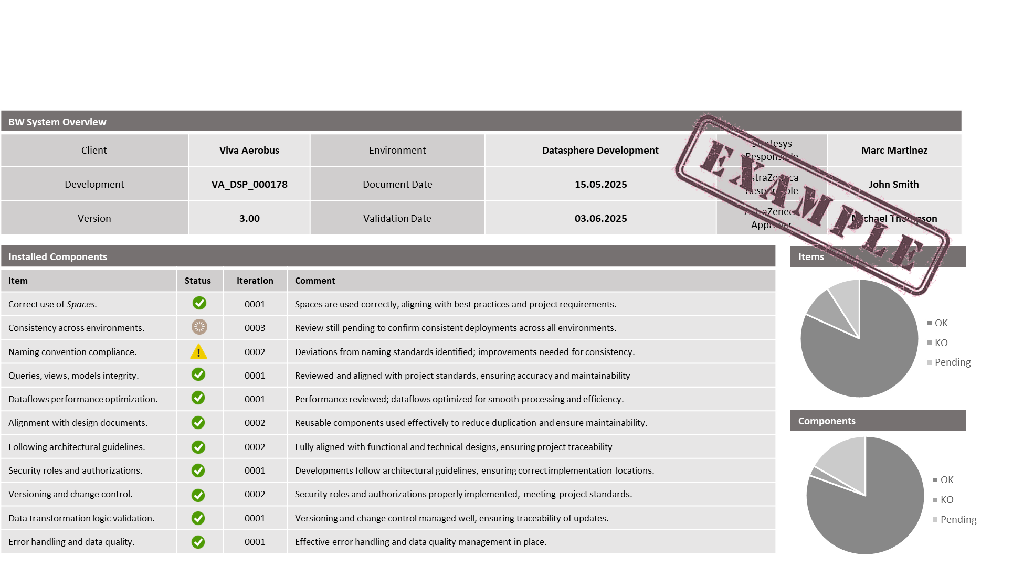
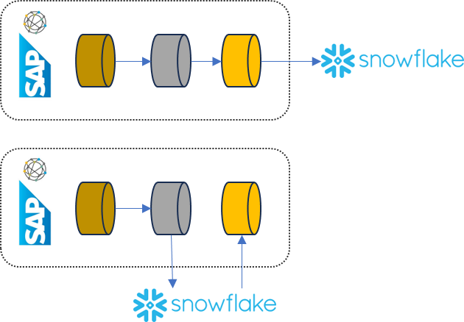
Advisory Process
Best Practices Datasphere
This advisory process will be applied to developments already completed, using an iterative approach:
1. Review
2. Recommendations
In-depth review of existing developments and documentation.
Validation of architecture, technical standards, and best practices.
Actionable improvement proposals based on findings.
Prioritisation of improvements according to impact and feasibility.
3. Implementation
Implementation of recommended actions by the third-party teams.
Support and follow-up to ensure proper execution.

Slide 19
Advisory
Actionable
1. As-Is
2. Way Forward
Review one (1) dataflow with up to ten (10) associated tables, ensuring alignment with architecture, naming conventions, and best practices.
2 Weeks
Two (2) dedicated team members working alongside the project team. Continuous reviews, recommendations, and support to ensure alignment with best practices and project standards.
End of 2025

Slide 20
Summary
Actionables
Access Control
Data Governance
1. App
1. Catalogue & Lineage
2. Data Quality
Build PoC App for 10 users and 1 approver.
7 - 9 Weeks
Review one (1) dataflow with up to ten (10) associated tables, ensuring alignment with architecture, naming conventions, and best practices.
2 - 4 weeks
Configure the Data Quality Rules available for the assets of one (1) business area and up to ten (10) unique assets with up to ten (10) rules per asset. Also, plug-in the Data Quality Monitor.
4 - 5 weeks
Advisory
1. As-Is
Review one (1) dataflow with up to ten (10) associated tables, ensuring alignment with architecture, naming conventions, and best practices.
2 Weeks
3. Security
4. Collibra
Configure “Admin Monitor” for SAC and Datasphere.
1 - 3 weeks
Integrate Datasphere to Collibra.
3 - 5 weeks
2. Way Forward
Two (2) dedicated team members working alongside the project team. Continuous reviews, recommendations, and support to ensure alignment with best practices and project standards.
End of 2025

Slide 22

Data Driven Business
CORPORATE BROCHURE

Slide 23
Data Governance
Best Practices Datasphere
Data Governance seeks alignment with a Data Driven AI Organization (Data culture + Technology) strategy, where data is a strategic asset.
It is based on the following pillars:
Structure and leadership for data management. Organisational models, committees and key guidelines. Combines effective communication.
Organisation
Guarantees key data (customers, products, employees, etc.). Applies consolidation and normalisation rules to achieve a reliable and unified view of information.
It ensures accurate, complete and always up-to-date data. It establishes business rules and general rules.
Lineage and Catalogue
Quality
Master Data
Protects information through encryption, controls, and compliance. Role- and attribute-based access rules and levels are set.
Security
Discovery of the origin and path of data with full transparency. Centralise catalogues, glossaries, and metadata management.
Architecture
Organise, integrate, and align data efficiently. It employs governance, monitoring, and exploitation tools to maximise the value of information.

Slide 24
Data Governance
Best Practices Datasphere
Data Governance seeks alignment with a Data Driven AI Organization (Data culture + Technology) strategy, where data is a strategic asset.
It is based on the following pillars:
Security
Structure and leadership for data management. Organisational models, committees and key guidelines. Combines effective communication.
It ensures accurate, complete and always up-to-date data. It establishes business rules and general rules.
Quality
Organisation
Guarantees key data (customers, products, employees, etc.). Applies consolidation and normalisation rules to achieve a reliable and unified view of information.
Master Data
Protects information through encryption, controls, and compliance. Role- and attribute-based access rules and levels are set.
Lineage and Catalogue
Architecture
Discovery of the origin and path of data with full transparency. Centralise catalogues, glossaries, and metadata management.
Organise, integrate, and align data efficiently. It employs governance, monitoring, and exploitation tools to maximise the value of information.

Slide 25
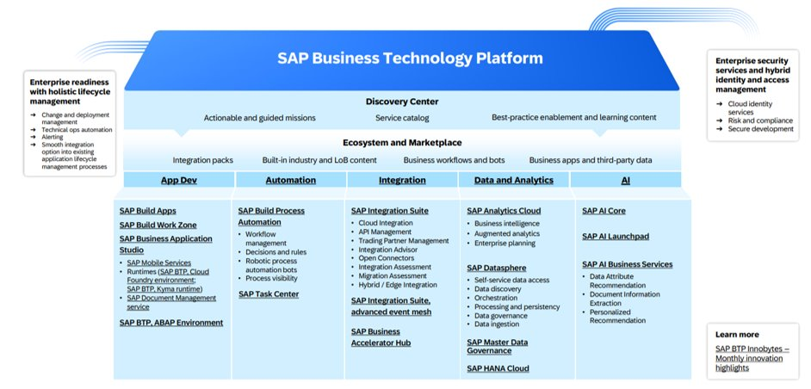
SAP BTP
SAP BTP enables organisations to outperform the competition, drive business value, and deliver great customer experiences, all through a single platform that includes applications, automation, integration, data and analytics, and artificial intelligence.

Slide 26



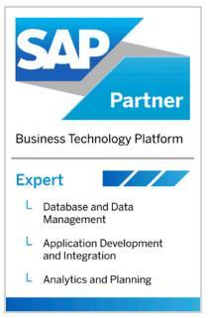
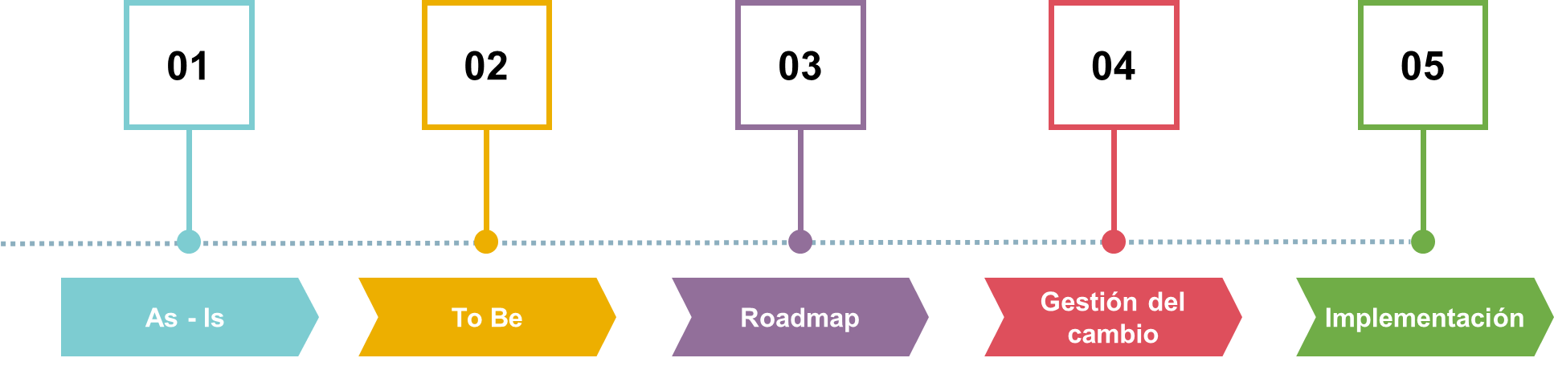
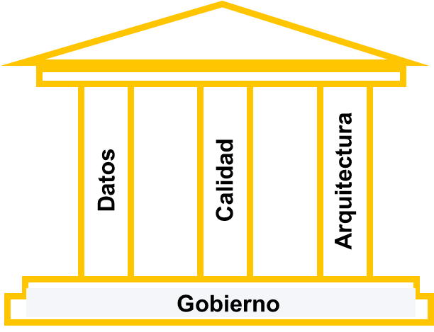



115 M€
1,500+
1,800+
PROJECTS IN 60+ Countries
Spain Portugal UK Brazil Mexico Argentina Colombia Chile Germany Netherlands
2023 REVENUE
CLIENTS
PROFESSIONALS
TEAM
200FTE
+350 projects/year
+1000 references
+300 clients
ACCELERATORS
BY STRATESYS
Evaluation
Platforms
Governance
Engineering
Modelling
AI & ML
EPM
PEOPLE
FINANCE
INDUSTRY
Analysis
We evaluate and define a roadmap just for your company
We identify, implement and adapt the data platform to your needs
We implement an efficient and value-based governance model
Data integration, quality, and lineage
Democratizing Data Securely and Efficiently
Collaborative access and understanding of data
Evaluating and Implementing AI Solutions for Business
Development of financial planning tools
GLOBAL SPEND
SALES & RETAIL
PHARMA SALES
TRAVEL EXPENSES
DATA QUALITY
DATA
GOVERNANCE
AI/ML
STANDARD REPORTING
SAP BTP EXPERTS
E2E
Responsible AI
CoE
Services
FUNCTIONAL
KNOWLEDGE
USER
EXPERIENCE
STANDARDS OF VISUALIZATION
Notes:
Bolitas de Iván Piñar o Juan

Slide 27
Index
Index
Advisory
Audit and Recommendations
Architecture
Best Practices Datasphere
On-going (nombre que mole más) auditoria y mejora continua y asegurar la Calidad…
Data Governance by Stratesys
Theory
Practice
Addressing AZ’s needs
Catalogue & Lineage
Quality
Security
Automatic Access Control
BTP
Proposed Flow

Slide 28
Advisory Process
Best Practices Datasphere
A comprehensive review of SAP Datasphere developments and documentation to ensure alignment with best practices, standards, and project goals, covering both completed and ongoing workstreams:
Documentation Review
Why and What:
Guarantees quality and alignment with actual developments.
Functional & technical designs.
Test documents and KPIs.
Reconciliation guides, GAPS, lessons learned.
Best Practices & Compliance
Why and What:
Ensures developments meet standards and security.
Roles & authorizations.
Technical names validation across the system.
Versioning, security, governance.
SAP Datasphere Advisory
Ensuring quality, compliance, risks and best practices in all developments (completed and ongoing).
Developments Review
Why and What:
Ensures correct use of spaces and object structures.
Queries, models, dataflows.
Use of spaces and consistency checks.
Architecture Review
Why and What:
Ensures a clear definition of architecture and responsibilities.
Guarantees that developments are done in the right place (where they belong).
Clear guidelines on “where to do what”
Compliance with best practices

Slide 29
Advisory Process
Best Practices Datasphere
This advisory process will be applied to developments already completed, using an iterative approach:
1. Review
2. Recommendations
In-depth review of existing developments and documentation.
Validation of architecture, technical standards, and best practices.
Actionable improvement proposals based on findings.
Prioritisation of improvements according to impact and feasibility.
3. Implementation
Implementation of recommended actions by the third-party teams.
Support and follow-up to ensure proper execution.

Slide 30




Advisory Process
Example of a review document
BW System Overview
Client | Viva Aerobus | Environment | Datasphere Development | Stratesys Responsible | Marc Martinez
Development | VA_DSP_000178 | Document Date | 15.05.2025 | AstraZeneca Responsible | John Smith
Version | 3.00 | Validation Date | 03.06.2025 | AstraZeneca Approver | Michael Thompson
Installed Components
Item | Status | Iteration | Comment
Correct use of Spaces. |  | 0001 | Spaces are used correctly, aligning with best practices and project requirements.
Consistency across environments. |  | 0003 | Review still pending to confirm consistent deployments across all environments.
Naming convention compliance. |  | 0002 | Deviations from naming standards identified; improvements needed for consistency.
Queries, views, models integrity. |  | 0001 | Reviewed and aligned with project standards, ensuring accuracy and maintainability
Dataflows performance optimization. |  | 0001 | Performance reviewed; dataflows optimized for smooth processing and efficiency.
Alignment with design documents. |  | 0002 | Reusable components used effectively to reduce duplication and ensure maintainability.
Following architectural guidelines. |  | 0002 | Fully aligned with functional and technical designs, ensuring project traceability
Security roles and authorizations. |  | 0001 | Developments follow architectural guidelines, ensuring correct implementation locations.
Versioning and change control. |  | 0002 | Security roles and authorizations properly implemented, meeting project standards.
Data transformation logic validation. |  | 0001 | Versioning and change control managed well, ensuring traceability of updates.
Error handling and data quality. |  | 0001 | Effective error handling and data quality management in place.
Items
Components

Slide 31

Architecture
2 Scenarios
Side-by-side evaluation of 2 architectures (all-Datasphere, Snowflake-hybrid).
+

Slide 32
Advisory Process
Best Practices Datasphere
Next Steps
No. | Item | Description | Duration
1 | As-Is | We will focus on reviewing a single dataflow with up to ten associated tables, ensuring alignment with architecture, naming conventions, and best practices. | 2 weeks
2 | On-going | Will involve two dedicated team members working alongside the project team until the end of the year, providing continuous reviews, recommendations, and support to ensure alignment with best practices and project standards. | 2 FTEs until 31st December 2025
3 | Architecture | We will conduct a high-level architecture review to assess whether using only SAP Datasphere or integrating Snowflake provides the best technical and business fit for the project’s future needs. | 1 week

Slide 33

Advisory Process
Best Practices Datasphere & SAC
On-going Service: Next Steps
Esto es un proceso iterative
Reviso
Recomendaciones
implementamos

Slide 34
Advisory Process
Best Practices Datasphere & SAC
Review of current and past developments
The advisory will cover both already completed developments and those in progress.
Identification of potential improvements and risks in current and ongoing developments.
Actionable recommendations to align all developments with the project’s quality and best practices.
SAP Datasphere Advisory/Audit Project Objective: Review and validate developments, ensuring they comply with best practices, standards, and required documentation.
🔎 Key areas of review:
Project Documentation
Validation of functional and technical designs.
Review of documentation for reports, KPIs, and business requirements.
Verification of test documents and reconciliation guides.
Check inventory of created objects and GAPS.
Analysis of lessons learned documentation.
Developments in SAP Datasphere
Correct use of spaces and structures within Datasphere.
Review of developed objects: queries, models, views, dataflows, etc.
Validation of technical naming conventions following defined standards.
Consistency checks between functional and technical documentation and actual developments.
Validation of compliance with SAP Datasphere best practices.
Proper use of roles, authorizations, and security settings.
Quality control and consistency of developments.
Review of versioning and change control procedures.
Project management review
Participation in follow-up meetings (weekly and monthly).
Identification of deviations and risks.
Recommendations and action plans for improvements.

Slide 35
1. Advisory / Quality Control
BEA y Toni
definir el servicio de la 1
Cómo es el servicio
Beneficio que tiene
Rol
Proceso
Cuáles son las buenas practices
Diseños funcionale sy técnicos
Con este servicio: Las 3 cosas de la otra diapositiva
Notes:
Bea & ToniDefinir el servicio “Advisory & Quality Control” - Descripción breve del servicio. - Beneficios tangibles (estandarización, riesgo ↓, coste de retrabajo ↓). - Roles implicados (consultor senior 2 días/sem, cliente SME, comité de diseño). - Proceso: Setup inicial → revisión periódica de diseños → informe quincenal. - Buenas prácticas que auditamos (nomenclatura, capas, spaces, políticas SAP).▸ Inspiraos en los advisory de Planning y S/4 que ya tenemos. ▸ Pedid a Miguel/Arturo plantillas de “Design Review Log”.

Slide 36
1. Advisory / Quality Control
BEA y Toni
Para la 1
Fotos
Plantillas
Lo que se vea visual
Para la 2
Una arquitectura
Notes:
Bea & ToniVisuales del servicio - Foto/plantilla ejemplo de Design Review marcada con comentarios (“nomenclatura incorrecta”, etc.). - Gráfico simple de “ciclo de mejora continua” (Entradas → Revisión → Feedback → Remediación).▸ Reutilizad capturas de proyectos BW → DS or Planning; si no existen, mock-up rápido en PPT.

Slide 37
1. Advisory / Quality Control
BEA y Toni
Nomenclature
Layers
Spaces
# | Pitch module | What you offer | Why Simon cares | Quick proof / activity
1 | Datasphere Quality Sprint (4-6 weeks) | Deep-dive review of spaces, layers, naming, canonical mapping, performance. | Gives him hard evidence to challenge Accenture and a remediation backlog he can fund. | • Annotated model diagram • Top-20 quick-wins with effort/impact
2 | Architecture & Integration Options Workshop | Side-by-side evaluation of 3 patterns (all-Datasphere, all-Snowflake, hybrid). | He must “bet now” on facts & dims without locking himself in. | • Decision matrix (cost, latency, semantics) • 6-month “no-regrets” roadmap
3 | Acompañamiento “constante” | Una persona que vaya revisando todo lo que produzca Accenture | Que lo que le entregue Accenture está bien | Acompañamiento
Notes:
Bea & ToniTabla de módulos (ya está) Revisar texto, afinar: 1. Datasphere Quality Sprint (4-6 semanas) 2. Architecture & Integration Workshop 3. Acompañamiento continuo (Advisory)▸ Añadid una fila “Quick Pilot” (4-5 semanas) con rango de tiempo, no de jornadas.

Slide 38
2. Data Governance
Juan
Cómo entendemos el data governance,
Te preocupan:
linaje
Calidad
seguridad
Notes:
JuanVisión global de Data Governance - Panteón con los 6 bloques clásicos (Política, Catálogo, Calidad, Linaje, Seguridad, Uso/FinOps). - Resaltar los que le duelen a Simon (linaje, calidad, seguridad).▸ Puedes reusar el “panteón” de Ortifrut / Envases.

Slide 39
Data Driven Business
Data Governance seeks alignment with a Data Driven AI Organization (Data culture + Technology) strategy, where data is a strategic asset.
It is based on the following pillars:
Data Governance
Structure and leadership for data management. Organisational models, committees and key guidelines. Combines effective communication.
Organisation
Guarantees key data (customers, products, employees, etc.). Applies consolidation and normalisation rules to achieve a reliable and unified view of information.
It ensures accurate, complete and always up-to-date data. It establishes business rules and general rules.
Lineage and Catalogue
Quality
Master Data
Protects information through encryption, controls, and compliance. Role- and attribute-based access rules and levels are set.
Security
Discovery of the origin and path of data with full transparency. Centralise catalogues, glossaries, and metadata management.
Architecture
Organise, integrate, and align data efficiently. It employs governance, monitoring, and exploitation tools to maximise the value of information.

Slide 40
















Data Driven Business
Data Governance seeks alignment with a Data Driven AI Organization (Data culture + Technology) strategy, where data is a strategic asset.
It is based on the following pillars:
Data Governance
Organisation
Lineage and Catalogue
Quality
Master Data
Security
Architecture
Notes:
Mejorar la diagramación

Slide 41
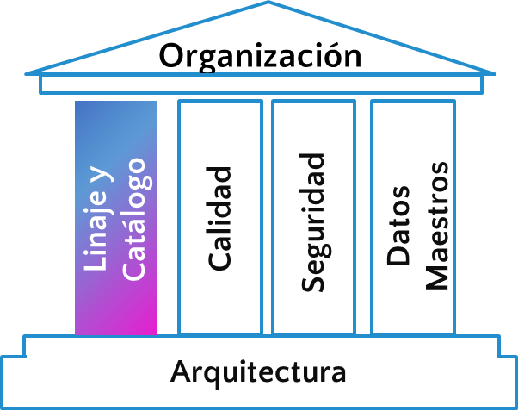
Data Driven Business
Catalogue
Domain map
The process of understanding and classifying data is as follows:
The domain map allows you to classify the information according to the functional area, which allows you to segment the available information from a functional point of view and facilitates the assignment of ownership of the different elements.
Processes
The business processes involved in the creation and exploitation of information are analysed.
Business Glossary
The business glossary is a classification of the indicators used by business, with their definition, method of calculation, origin in products/reports where they are found. It provides a common business vocabulary for the organisation.
* Can be automated with the Auto Business Catalogue by STR
Reports
Classification and prioritisation
The main reports in the business processes are identified.
In this step, the acquired information is classified according to the criticality of the information to prioritise the most relevant information.
Data Catalogue
Structures
The data catalogue is an inventory of the data objects, with the source, intermediate tables, visualizations, and ML and AI.
* It can be automatable in tools such as OpenMetadata, Collibra, Purview, DataSphere, etc.
Data repositories that support the reports are identified.

Slide 42
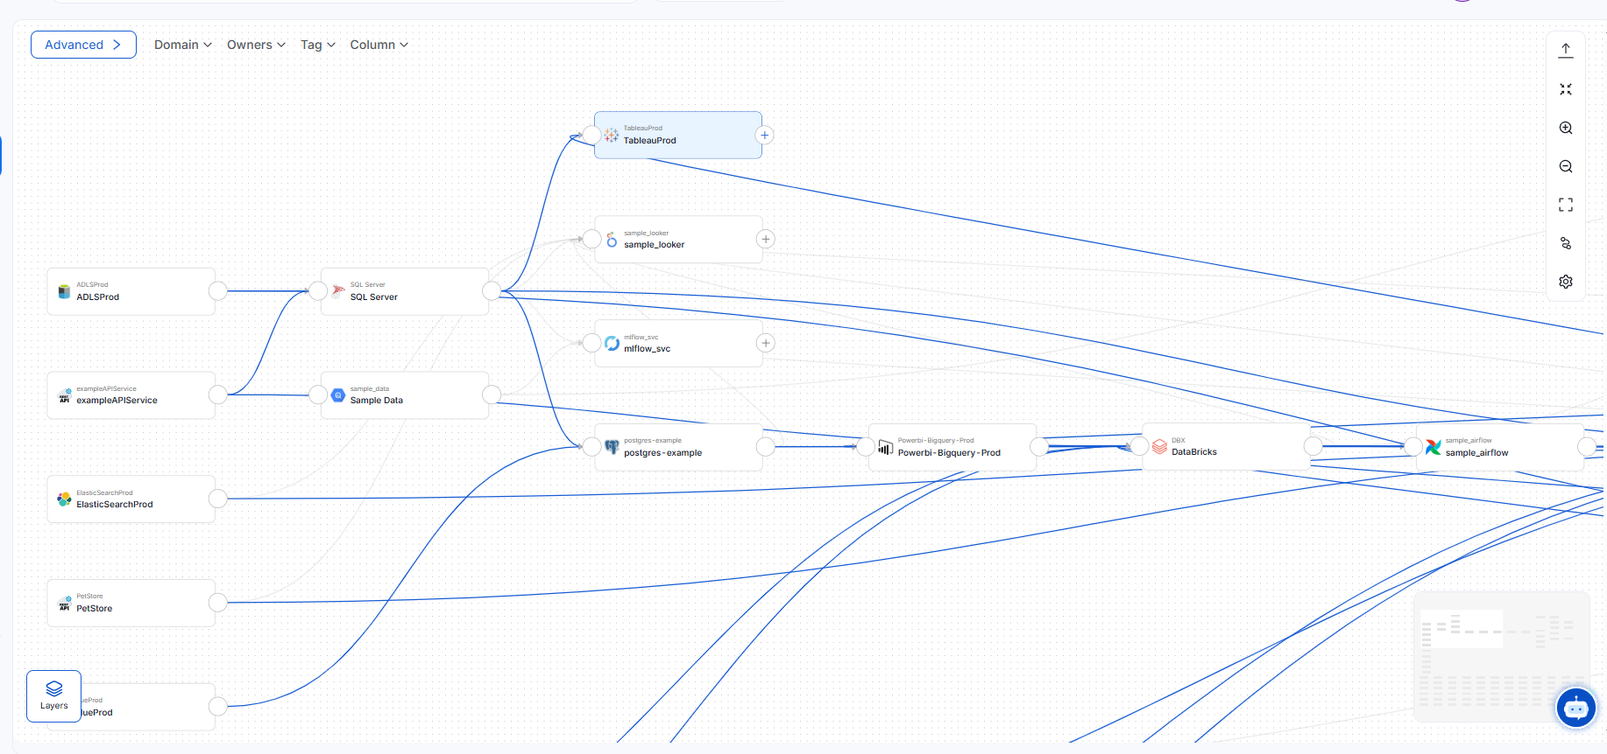

Data Driven Business
Lineage
We visualise and document how data travels, transforms, and connects throughout its entire lifecycle:
Origin
Transformation
Destiny
Where a piece of information comes from
How it is modified or calculated
Where it is consumed or presented
Benefits
Transparency, traceability and trust in data. Multidimensional view: technical (systems and columns) + logic (rules) + business (consumption) Give visibility and context to each piece of data, enabling informed decisions and proactive change management Impact analysis, audits, error resolution, and end-user confidence.
Notes:
🔄 ¿Qué es el linaje de datos según DMBOK2?
DMBOK2 (especialmente en los capítulos de Metadata Management y Data Integration) presenta el linaje como una pieza crítica para la transparencia, trazabilidad y confianza en los datos. Incluye:
Orígenes (de dónde proviene un dato)
Transformaciones (cómo se modifica o calcula)
Destino (dónde se consume o presenta)
Puede abarcar niveles técnicos (ETL, columnas, tablas), lógicos (reglas de negocio), y de usuario final (dashboards, reportes).
🧭 ¿Cómo lo presentarías en una diapositiva?
🔍 Linaje: Trazabilidad como motor de confianza
Visualizamos y documentamos cómo los datos viajan, se transforman y se conectan a lo largo de todo su ciclo de vida.
Representación completa del flujo de datos: origen, transformación, destino.
Vista multidimensional: técnica (sistemas y columnas) + lógica (reglas) + de negocio (consumos).
Apoyo al análisis de impacto, auditorías, resolución de errores y confianza del usuario final.
🎯 Objetivo: Dar visibilidad y contexto a cada dato, habilitando decisiones informadas y gestión proactiva del cambio.

Slide 43
Datasphere Catalog

Slide 44
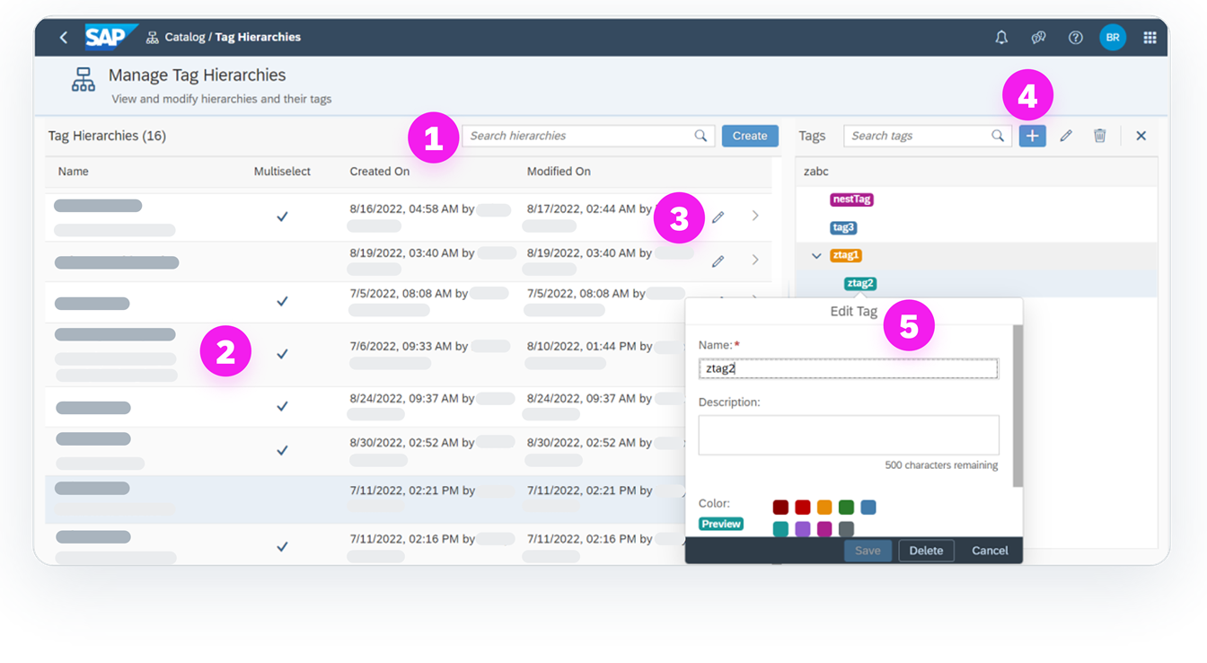
Datasphere Catalog
Function | Description
(1) Search | Allows you to do a free-text search in tag hierarchies.
(2) Results | The main area of the page that shows you the hierarchy, description, and hierarchy details.
(3) Edit | Allows users who have the Catalog Admin role to edit the hierarchy or tag.
(4) Create Label | Allows you to create a tag or bottom tag below an existing top tag.
(5) Edit Label | Allows you to modify the name, description, or color of the label.

Slide 45
Datasphere Catalog

Slide 46
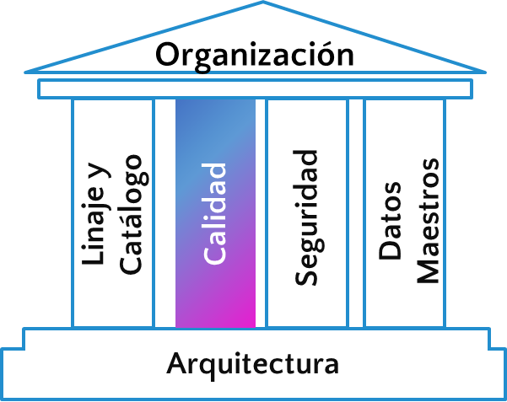
Data Driven Business
Quality
Our approach to managing the data quality process is based on the execution of iterative cycles of refinement, according to the following scheme:
Phase 0.
Data Exploration and Application of Standard Rules
Phase 1.
Data Health (Monitoring)
Phase 2.
Definition of corrective actions and remediation plans
Profiling
General Rules
Null Duplicate Inconsistencies
Once the rules with the objective values have been defined, information quality monitors are established, classifying the errors according to their importance.
Rules: Existing rules are updated and new rules are defined.
Controls: Checks that at points in the flow of information.
Remediation Plans: Actions to address errors in data quality.
Phase 3.
Implementation
Controls and improvements are applied to the quality rules.

Slide 47
Datasphere Data Quality
2nd Phase
Definition of corrective actions and remediation plans
1st Phase
Data Health
(Monitoring)
3rd Phase
Implementation
1. Format correction and adaptation
HANA SQL, SQLScript, and Python have hundreds of formatting and syntax adaptation functions that allow you to automatically correct typos and enrich data using custom logic.
2. Data error detection and alerting
Using SAP Analytics Cloud, you can create alerts associated with data that allow you to automate the detection and notification of errors graphically or by e-mail.
3. Correction in external systems
Through direct integration of SAP Datasphere with external systems with ODATA or replication flow, correction of data at transactional source is possible. (External system must be supported)
DATA QUALITY DASHBOARD
- Identification of duplications - Master data grouping - Field cleanup and exclusion filters - Enrichment with the generation of additional fields, groupings or rankings.

Slide 48
Datasphere Data Quality
Notes:
Supplier DataQuality - Stories - SAP Analytics Cloud

Slide 49
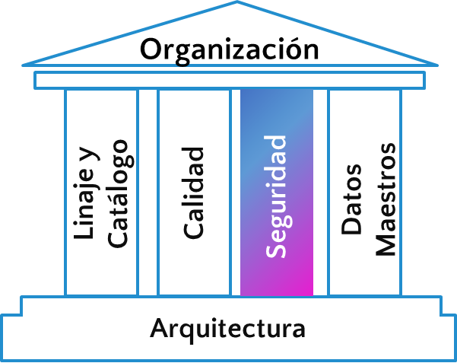
Data Driven Business
Security
Compliance Support
Access Management
Usage and Consumption Controls
Define, assign, and manage access rights using role-based access (RBAC) and attribute-based access (ABAC) models Traceability of access and authorization decisions.
Monitor and restrict the use of data and tools Auditing of events and unusual behaviour
Automate regulatory requirements Scheduled deletion or anonymization of personal data (e.g. GDPR) Registration and justification of the data life cycle (data retention policies). Evidence of access, processing and elimination in the event of audits.
Notes:
🔐 Seguridad: Tres productos clave
1. Gestión de Accesos (Access Management)
Capacidad para definir, asignar y gestionar derechos de acceso mediante modelos RBAC y ABAC:
Asignación dinámica de permisos según rol, función o atributos (hora, ubicación, sensibilidad del dato...).
Interoperabilidad con herramientas de identidad y single sign-on (SSO).
Trazabilidad de accesos y decisiones de autorización.
🎯 Objetivo: Garantizar el acceso correcto al dato correcto por el perfil correcto, minimizando el riesgo operativo y habilitando el autoservicio seguro.
2. Controles de Uso y Consumo (Consumption & Usage Controls)
Supervisión y restricción del uso de datos y herramientas:
Políticas sobre lectura, modificación, exportación, combinación o persistencia de datos.
Límites de frecuencia o volumen de consumo (rate limiting, quota, etc.).
Auditoría de eventos y comportamiento inusual (ej. consultas masivas o fuera de horario).
🎯 Objetivo: Asegurar un uso responsable y eficiente del dato sin fricciones para los usuarios.
3. Apoyo al Cumplimiento Normativo (Compliance Support)
Automatización de requisitos regulatorios sin comprometer la agilidad:
Eliminación programada o anonimización de datos personales (ej. RGPD, CCPA).
Registro y justificación del ciclo de vida del dato (data retention policies).
Evidencias de acceso, tratamiento y eliminación ante auditorías.
🎯 Objetivo: Facilitar el cumplimiento normativo desde la arquitectura, con bajo impacto operativo.

Slide 50
Data Driven Business
Security
Admin Monitor
https://stratesys-ts.eu10.hcs.cloud.sap/sap/fpa/ui/tenants/6bdd2/bo/story/8A8032065263163B58BDCEE7CB7C1A84
Notes:
🔐 Seguridad: Tres productos clave
1. Gestión de Accesos (Access Management)
Capacidad para definir, asignar y gestionar derechos de acceso mediante modelos RBAC y ABAC:
Asignación dinámica de permisos según rol, función o atributos (hora, ubicación, sensibilidad del dato...).
Interoperabilidad con herramientas de identidad y single sign-on (SSO).
Trazabilidad de accesos y decisiones de autorización.
🎯 Objetivo: Garantizar el acceso correcto al dato correcto por el perfil correcto, minimizando el riesgo operativo y habilitando el autoservicio seguro.
2. Controles de Uso y Consumo (Consumption & Usage Controls)
Supervisión y restricción del uso de datos y herramientas:
Políticas sobre lectura, modificación, exportación, combinación o persistencia de datos.
Límites de frecuencia o volumen de consumo (rate limiting, quota, etc.).
Auditoría de eventos y comportamiento inusual (ej. consultas masivas o fuera de horario).
🎯 Objetivo: Asegurar un uso responsable y eficiente del dato sin fricciones para los usuarios.
3. Apoyo al Cumplimiento Normativo (Compliance Support)
Automatización de requisitos regulatorios sin comprometer la agilidad:
Eliminación programada o anonimización de datos personales (ej. RGPD, CCPA).
Registro y justificación del ciclo de vida del dato (data retention policies).
Evidencias de acceso, tratamiento y eliminación ante auditorías.
🎯 Objetivo: Facilitar el cumplimiento normativo desde la arquitectura, con bajo impacto operativo.

Slide 51
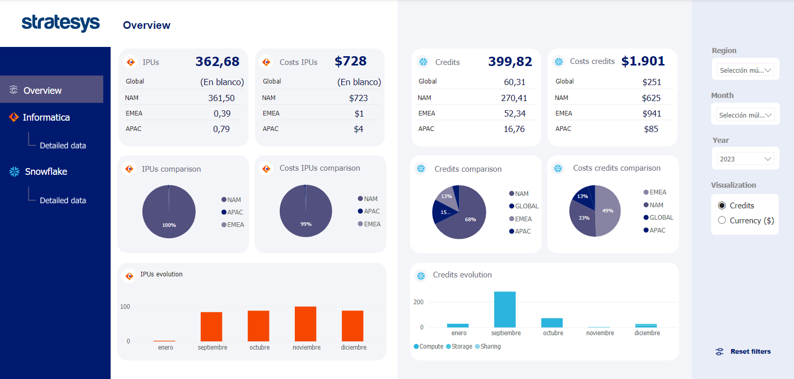
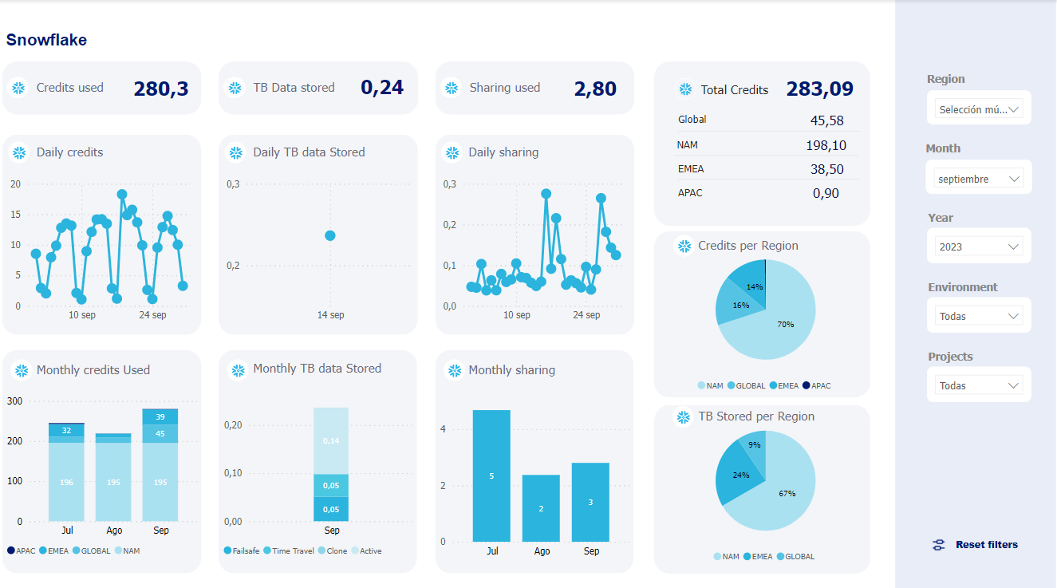
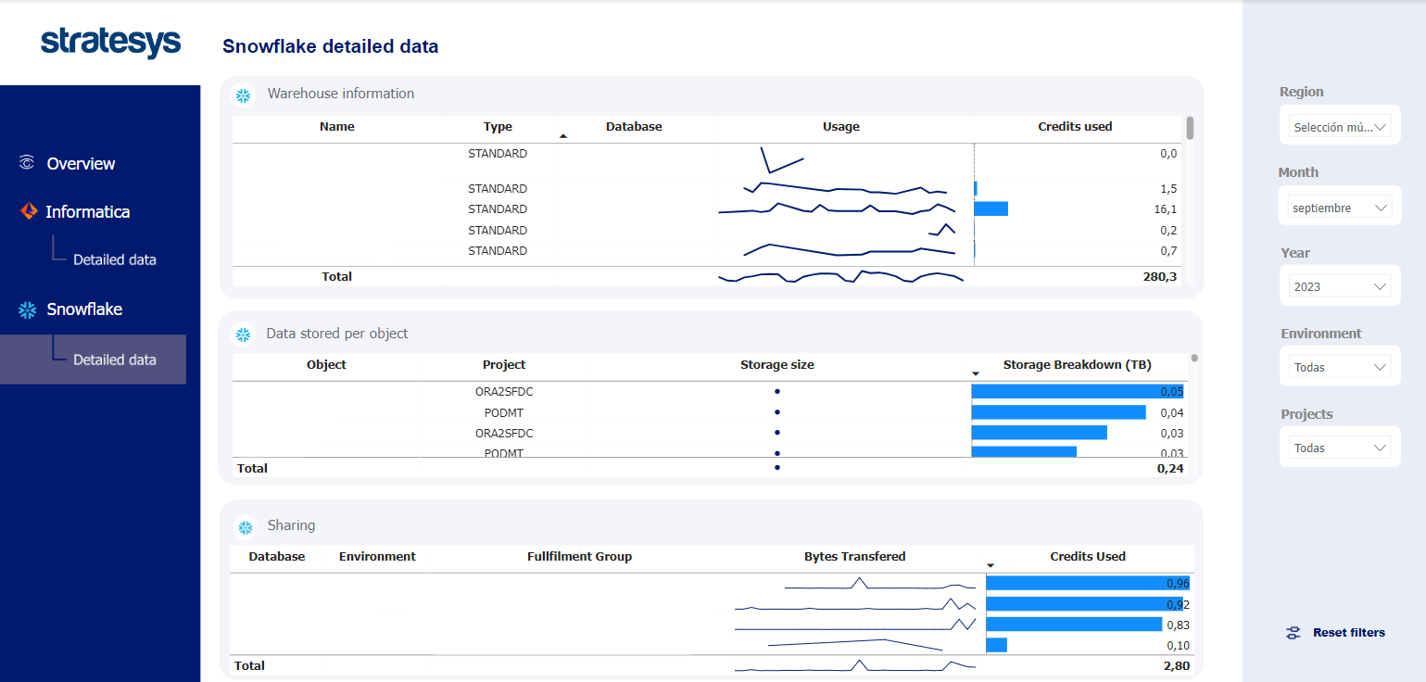
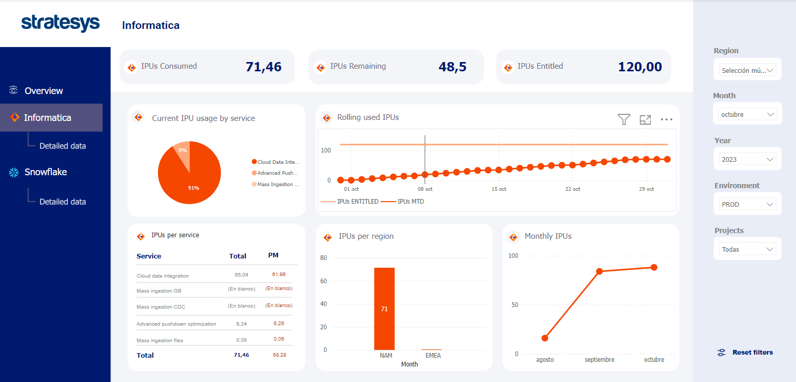
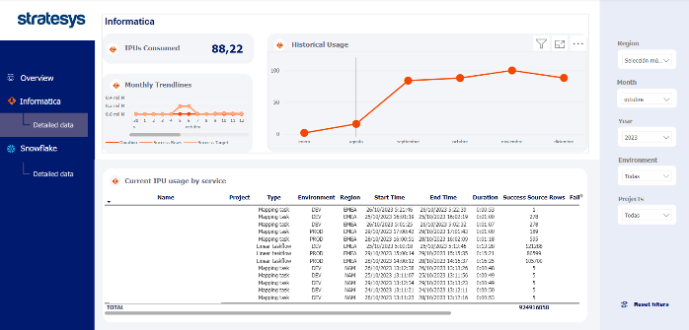
Data Driven Business
Security
Cost Monitor
It allows the organisation to control the consumption and expenses of tools through views and reports.
Budget planning: It helps to allocate resources effectively.
Transparency and accountability: It keeps stakeholders informed and encourages accountability.
ROI Evaluation: Determine if the investment is generating the expected benefits.
Informed decision-making: Provides data for decisions about use, renovation, or replacement.
Identification of opportunities for improvement: Identify areas to increase efficiency and reduce expenses.
Cost optimization: Identify areas of savings and wasted resources.

Slide 52
Data Driven Business
Security
No. | Item | Description | Duration
8 | Security | We will configure “Admin Monitor” for SAC and Datasphere access control. | 1 week
9 | Security | We will configure “Cost Monitor” for SAC and Datasphere usage metrics. | 3 weeks
Notes:
🔐 Seguridad: Tres productos clave
1. Gestión de Accesos (Access Management)
Capacidad para definir, asignar y gestionar derechos de acceso mediante modelos RBAC y ABAC:
Asignación dinámica de permisos según rol, función o atributos (hora, ubicación, sensibilidad del dato...).
Interoperabilidad con herramientas de identidad y single sign-on (SSO).
Trazabilidad de accesos y decisiones de autorización.
🎯 Objetivo: Garantizar el acceso correcto al dato correcto por el perfil correcto, minimizando el riesgo operativo y habilitando el autoservicio seguro.
2. Controles de Uso y Consumo (Consumption & Usage Controls)
Supervisión y restricción del uso de datos y herramientas:
Políticas sobre lectura, modificación, exportación, combinación o persistencia de datos.
Límites de frecuencia o volumen de consumo (rate limiting, quota, etc.).
Auditoría de eventos y comportamiento inusual (ej. consultas masivas o fuera de horario).
🎯 Objetivo: Asegurar un uso responsable y eficiente del dato sin fricciones para los usuarios.
3. Apoyo al Cumplimiento Normativo (Compliance Support)
Automatización de requisitos regulatorios sin comprometer la agilidad:
Eliminación programada o anonimización de datos personales (ej. RGPD, CCPA).
Registro y justificación del ciclo de vida del dato (data retention policies).
Evidencias de acceso, tratamiento y eliminación ante auditorías.
🎯 Objetivo: Facilitar el cumplimiento normativo desde la arquitectura, con bajo impacto operativo.

Slide 53
Datasphere Catalog
Next Steps
No. | Item | Description | Duration
4 | Catalogue | We will review and complete, if necessary, the current metadata in Datasphere’s Catalog for one business area and up to 10 unique tables with up to 20 fields per table. | 2 weeks
5 | Lineage | We will map out the lineage for the business area and for the data assets catalogued in the previous step. | 2 weeks
Notes:
Primero algo pequeño tipo Pilot, luego escalarlo
ejemplo: 1 Sistema y un área functional y pocos usuarios
Ejecución tipo QuickWins
Se valora el quick win
Qué es el quick win (1 area functional, 1 Sistema)

Slide 54
Datasphere Data Quality
No. | Item | Description | Duration
6 | Quality Rules | We will configure the Data Quality Rules available in Datasphere for the assets of one business area and up to 10 unique assets with up to 10 rules per asset. | 2 weeks
7 | Quality Monitor | We will configure the Data Quality Dashboard in SAC feeding from the data quality rules set up in the previous step. | 2 weeks

Slide 55
+
Essential for collaboration and democratization of data. It enables users to discover, understand, and prepare business data. Improve productivity by building trust in metadata through consistent data quality and governance. Users can search and filter data, view asset lineage and details, enrich and classify assets, and share them with other users.
Discover
Discover data (Track, profile, organize, link, and enrich) and create accessible data (browse, search)
Organize
Sort, organize, and understand data
(location, attributes, quality, lineage, sensitivity)
SAP Analytics Cloud*
SAP Datasphere**
Control
Apply centralized authorization and security for orchestration and control of data quality standards
Metadata
Data Lineage
Glossary
Classification
SAP BW4/HANA**
SAP ECC*
Cloud applications
SAP HANA Cloud**
On-premise sources
SAP S/4HANA**
Non-SAP data landscape
SAP data landscape

Slide 56
+
No. | Item | Description | Duration
10 | Data Governance | We will connect Datasphere with Collibra and ensure the metadata is flowing correctly from Datasphere’s Catalog into Collibra. | 3 weeks

Slide 57
2. Data Governance
DataSphere
Catalog
Lineage
Calidad
# | Pitch module | What you offer | Why Simon cares | Quick proof / activity
3.1 | Build Governance in Datasphere (catalog + lineage + quality) | • Turn on Datasphere catalog, activate technical lineage & impact analysis. • Configure rule-based data-quality scoring and alerts. • Enforce naming & canonical-model conventions in harmonisation layer. | Stops the “six naming standards in one view” problem and surfaces data issues before users see them. | •PILOTO Live lineage demo for Finance & Supply-Chain domains • Governance playbook v1.0
3.2 | Connect & Enrich in Collibra | • Bi-directional metadata sync (Datasphere API → Collibra). • Map technical lineage to business glossary & policies. • Stewardship workflow: request / approve / certify datasets. • Auto-publish quality scores & usage metrics. | Unifies AZ’s enterprise catalogue; lets 20 000 users find, trust and request data in one place. | • Collibra workspace populated with two critical domains • Sample “shopping-cart” access workflow
Notes:
ea & ToniMódulos 3.1 & 3.2 (tabla ya creada). - Añade “PILOTO 4-6 semanas” en Quick Proof.

Slide 58
2. Data Governance
Juan
Seguridad
Analítica
Dashboard de seguridad Iberdrola
Notes:
JuanDashboard de Seguridad (Iberdrola) - 1 captura real + 3 insights que resuelven (users sin rol, roles huérfanos, SoD).▸ Extrae pantallazo alta res del modelo Iberdrola.

Slide 59
2. Data Governance
Juan y Miguel y bea
Seguridad
Automatizaciones de accesos.. Flujos
Arquitectura de esto cómo se hace
Notes:
Juan & MiguelArquitectura de automatización de accesos - Diagrama simple: SAC (form) → BTP Workflow → API/CLI Datasphere (roles) → SAC refresh. - Componentes: Workflow Service, Destination, Kyma/API, CLI DS. - Incluye propuesta de “Pilot Access Flow” (ventas, 4-5 sem).▸ Habla con Tiago para validar piezas BTP.

Slide 60
Access Automation
Demo

Slide 61
2. Data Governance
Seguridad
Analítica
Automatizaciones
# | Pitch module | What you offer | Why Simon cares | Quick proof / activity
4 | Secure Self-Service & FinOps Automation | API-driven space/role provisioning, charge-back dashboards, privacy patterns for M&A/tax work. | Eliminates manual tickets and gives cost transparency. | • POC in non-prod tenant with automated approval
5 | Adoption & UX Enablement | Unified semantic layer + metric store, SAC & Power BI starter kits, tiered self-service playbook. | Keeps users from defaulting to legacy BI; “build once, consume many.” | • Twin reference dashboards (SAC + Power BI) on same KPI• 1-day user clinic
Notes:
JuanTabla módulos 4 & 5 (ya puesta) - Añadir rango “4-5 semanas – MVP” al POC de automatización. - Checklist de éxitos de UX (mismo KPI en SAC y Power BI).

Slide 62
Data Driven Business
SAP BTP enables organisations to outperform the competition, drive business value, and deliver great customer experiences, all through a single platform that includes applications, automation, integration, data and analytics, and artificial intelligence.
SAP BTP

Slide 63
Data Access Solution Architecture
Chatbot User request
Approval Workflow activation
Approval process completion
System access provision
User Notification
Access Allowed
Microsoft Teams using Auth2 connection
LLM Agentic Layer
SAP Workflow Management
Access to SAC or datasphere leveraging SAP Integration Suite API Management
Microsoft Teams using Auth2 connection
SAP/Datasphere access
Notes:
JuanTabla módulos 4 & 5 (ya puesta) - Añadir rango “4-5 semanas – MVP” al POC de automatización. - Checklist de éxitos de UX (mismo KPI en SAC y Power BI).
✅ Coincidencias claras con buenas prácticas:
Chatbot User Request (MS Teams)
✔️ Representa una buena entrada de solicitud, sobre todo si usas MS Teams integrado con SAP CAI (Conversational AI) o SAP Build Process Automation.
👉 Asegúrate de que el bot esté conectado con SAP BTP mediante canales seguros como OAuth2 y tenga permisos definidos para iniciar flujos de trabajo.
Approval Workflow Activation (SAP BTP)
✔️ Usar SAP Workflow Management (o ahora parte de SAP Build Process Automation) es el enfoque adecuado.
👉 Valida que el workflow esté modelado para múltiples aprobadores o reglas condicionales si aplica por tipo de acceso.
Approval Process Completion
✔️ Bien definido. Este es el punto clave para el "gatillo" de provisión de acceso.
❗ Hay un pequeño error ortográfico: “completition” debería ser “completion”.
API User Access Provision (SAP Datasphere)
✔️ Este es el corazón del proceso: usar las APIs de SAP Datasphere para otorgar permisos (roles, espacios, vistas).
👉 Confirma que estés usando APIs autenticadas por OAuth y aplicando políticas RBAC correctas.
User Notification (MS Teams)
✔️ Correcto, el usuario debe ser notificado una vez tenga acceso.
👉 Puedes usar SAP BTP destinations o Webhooks para esto desde el workflow.
Access Allowed (SAP Analytics Cloud + Datasphere)
✔️ Bien representado como objetivo final. Asumes que el usuario accede a datos desde SAC luego de tener los permisos desde Datasphere.
🔍 Qué podrías complementar o verificar:
¿Dónde se valida la identidad del usuario? La autenticación/autorización inicial (por ejemplo, mediante SAP Identity Authentication Service - IAS o Azure AD) no se ve reflejada.
Trazabilidad / Auditoría del proceso: Considera agregar un paso o componente para logging y cumplimiento normativo, especialmente si manejas datos sensibles.
Mecanismo de integración entre MS Teams y SAP BTP: Aunque usas Teams, no se especifica si estás usando SAP CAI, Power Automate, o un webhook directamente. Vale la pena especificarlo.
Fallback / Manejo de errores: ¿Qué pasa si el API call a Datasphere falla? Agrega una ruta para reintentos o alerta.
📌 Sugerencia visual:
Podrías insertar una capa transversal que diga algo como “Identity & Security Layer (IAS, Roles, OAuth)” o un pequeño ícono de seguridad al pie del flujo para reflejar la gestión de identidades y permisos.

Slide 64
BTP Workflow Demo

Slide 65
PoC Data Access Solution
No. | Item | Description | Duration
11 | Scope | Users: 10 end users + 1 approver Report: 1 existing SAC report connected to Datasphere | 5 – 7 weeks
 | Main tasks | Create request form in Teams chatbot, integrate with SAP BTP, validate OAuth2 permissions
 |  | Model approval flow, include multi-level rules, simulate scenarios (denied, escalated)
 |  | Configure RBAC policies in Datasphere, connect API calls to workflow outputs
 |  | Notify users (Teams/Webhook), test SAC access, simulate revoked access or change of role
 |  | Perform full testing, document outcomes, monitor audit logs, present results

Slide 66
Data Access Solution Architecture
Stage | Best Practices
Chatbot User Request | ✔️ Teams + SAP CAI or Build Process Automation👉 OAuth2 connection, defined permissions
Approval Workflow Activation | ✔️ SAP Workflow Management / Build Process Automation👉 Conditional approval rules, multi-level approvers
Approval Process Completion | ✔️ Access trigger point❗ Fix typo: “completition” → “completion”
API User Access Provision | ✔️ Datasphere APIs (RBAC)👉 OAuth2 authentication + properly enforced security policies
User Notification | ✔️ User notification after approval👉 Use Webhook or SAP BTP destinations
Access Allowed | ✔️ Access granted in SAC with correct roles/views🔍 Post-provision validation

Slide 67
Proposed Scope (summary)
No. | Category | Item | Description | Duration
1 | Advisory | As-Is |  | 4 – 6 weeks
2 | Advisory | On-going |  | 2 FTEs until 31st December 2025
3 | Advisory | Architecture |  | 1 week
4 | Data Governance | Catalogue |  | Depends on number of objects to catalogue 3 – 5 days per data Asset
5 | Data Governance | Lineage |  | Depends on number and complexity of the Lineage to construct 1 – 3 days per lineage “workstream”
6 | Data Governance | Security – Admin Dashboard |  | 1 week
7 | Data Governance | Security – Cost Control Dashboard |  | 2 weeks
8 | Data Governance | Collibra |  | TBD
9 | Automation | Access Control using BTP + APIs |  | 4 – 6 weeks

Slide 68





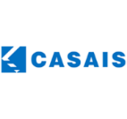























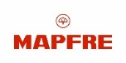














































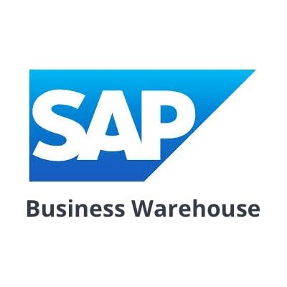












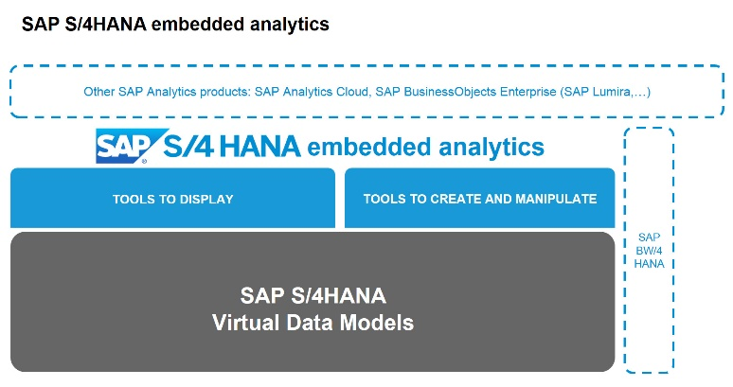




Data Driven Business - Analytics
People Analytics
Global Spend
Sales
Finance
Industry
Real Estate
Pharma
+70 References
ETL Invoicing Migration
IBM Maximo integration
Purchasing Model Migration
Financial Model Migration
BW and SAC Reporting Migration
Finance & Sales analysis
Sales Information
Replica model BW
Legal, Structure, Operational and Consolidation model migration
Implementation of dataflow for purchases and SAC Reports
+15 References
New analytics platform
BW Model Migration
Analytical models with SAC
New analytical models on S4
Business management in BW/4HANA 2.0.
Financial Management Project in BW/4HANA 2.0
BW/4HANA 2.0 consolidation project
BW/4HANA 2.0 Risk Analysis Project
+15 References
Remodeling the extraction layer and adapting the model to LSA++ in BW/4HANA 2.0
Laboratory to establish a strategic vision of information management with BW4HANA
Logistics management project in BW/4HANA 2.0
Deploying HANA as the corporate DataWarehouse
Support in budget process at BW IP
Corporate evolutions and supports
Sales, offers and income statement reports
Dashboards for LNG, HR, IT, Purchasing and Finance.
Budgeting, consolidation, and budget monitoring
Corporate support and evolutions
Support and
evolutions
Reporting and Strategic Indicators for Management
Engineering Resource Planning
HR Scorecard Design (HCM DATAMART)
+150 References
Development of analytical applications for treasury
FI Scorecard Development
Activation of S/4HANA analytical applications
FI Scorecard Development
Activation of S/4HANA analytical applications
+30 References
Activation of S/4HANA analytical applications
Activation of S/4HANA analytical applications
FI Scorecard Development
Development of FI and Group Reporting analytical applications
FI Report Development

Slide 69



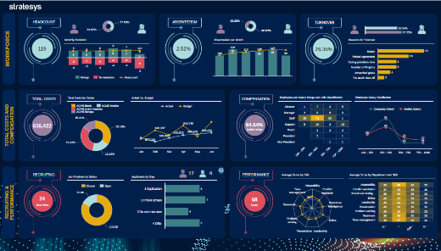
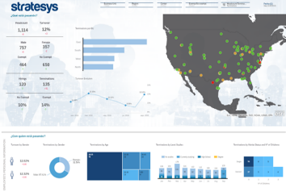








Analytics - Accelerators
+30 Accelerators by
HR INSIGHTS
REAL ESTATE
Complete reporting solution for all HR areas of the company, such as FTE, headcount, costs, turnover, absences or performance.
Real estate rerporting solution, to analyze stocks, assets, rent roll, contracting or pricing.
INDUSTRY
GLOBAL SPEND
Optimization of the manufacturing process based on a detailed analysis by plant and machine of production and OEE productivity, calculated by weighting availability, performance, quality and their evolution.
End-to-end analytics of the 5 main business axes: purchasing, suppliers, personnel costs, travel expenses and expense planning.
TRAVEL EXPENSES
Analysis of all components of the company's travel expenses, such as summary of expenses, detail of all travel records, approval or rejection of expenses and overall status of expenses.
PHARMA
360 MOBILITY
Complete reporting solution for all areas of the pharma industry, such as sales, sales force, market share, finance, purchasing and business planning.
A set of dashboards focused on urban passenger transport according to 4 key performance dimensions: service, environment, customer and corporation.
SUSTAINABILITY
SALES & RETAIL
Planning and control of the EEFF of the industrial sector. It allows to make a business plan, investment and amortization budget, General Expenses with full cost allocations, purchase planning and cost of sale, etc...
FINANCE
Complete reporting of all financial areas of the company: P&L, Balance Sheet, Capex and Opex, Debt, Cash Flow and debt control.
Complete retail analytics: sales, target planning, mall vision, ecommerce, sentiment analysis and benchmarking.

Slide 70
Migration to SAC Planning – Best Road to Cloud
Prepare
Execute
Discovery
Prepare
Realise / Deploy
Run
1
Analysis of the current environment and design of the optimal migration strategy based on own tools, accelerators and previous experiences
2
Detailed project preparation: schedules, test responsibles & data strategies
3
The detailed creation or conversion in previous phases is executed. In parallel, change management is carried out
4
Execution of the cutover and the coexistence plan (if applicable) Maintenance and support
Kickoff Housekeeping result Readiness check by STR results
Users & sizing calculation (licences) Analysis of the current system map
New reporting layer blueprint.
Approach to the different migration strategies (new functional redesign vs. technical migration).
Migration strategy decision matrix.​
Plan for coexistence between systems.​
Data transfer strategy Detailed project plan Phases, cutover plan and models coexistence Detailed Test Plan
SAC Data Governance Model
Chatbot SAC expert (ChatGPT)
Change management detail
Conversion objects detail Completed Tests plan
Performance tests results Transport request list Improvements document
Cutover
Model coexistence planning Technical and functional documentation List of incidents and improvements in support
KT documentation Project Closure Document
Tools &
deliverables
Minutes-of-Meeting Steering committee document
Monitoring committee document
Cross (all phases)

Slide 71
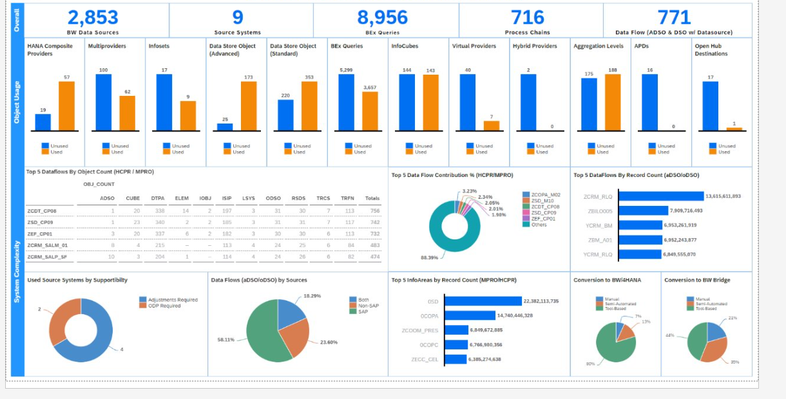
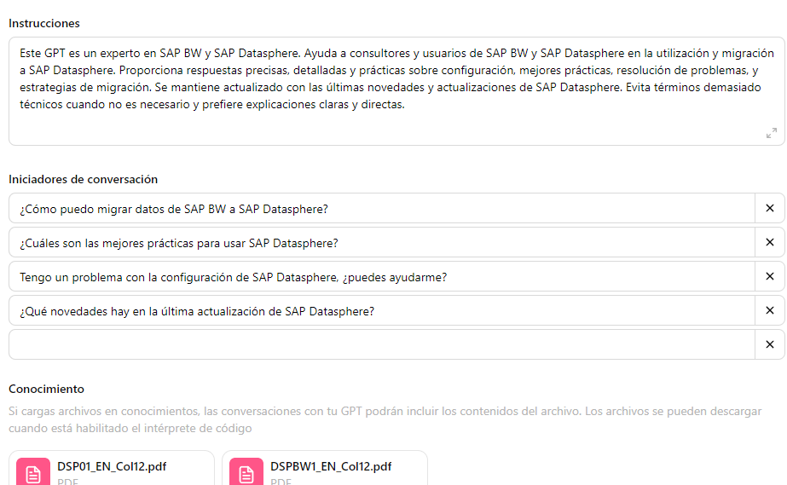
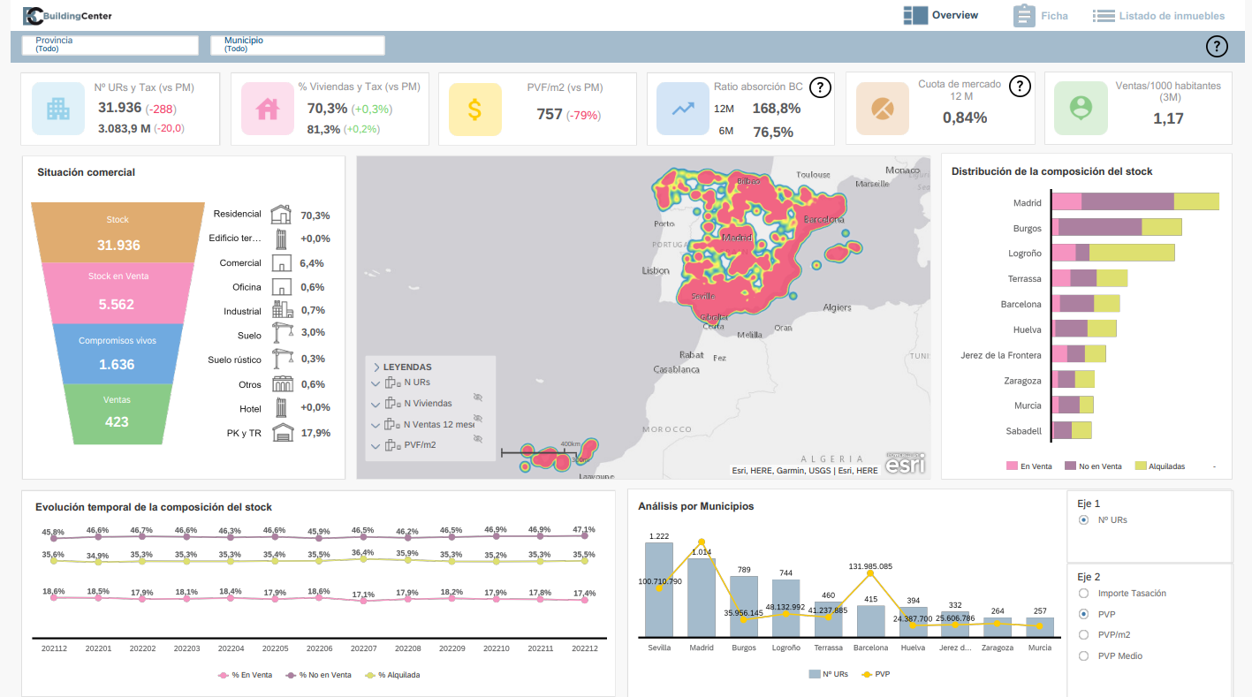
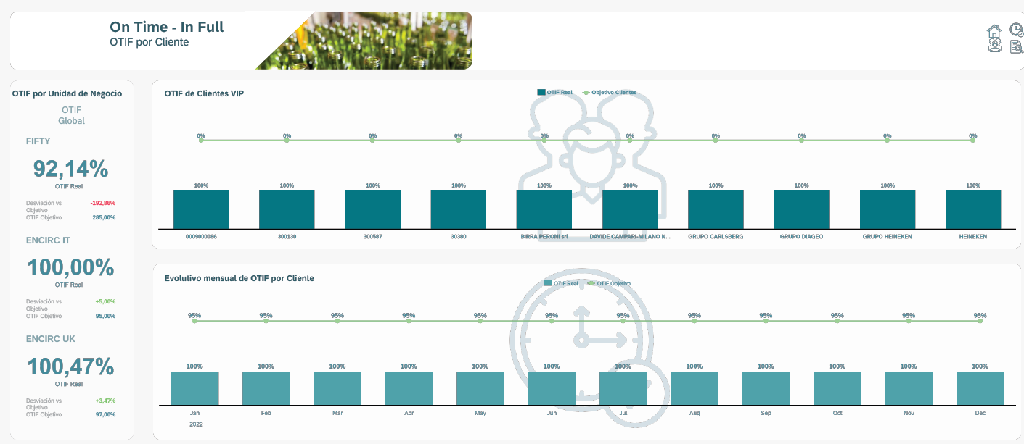
Migration to SAP Datasphere – Tools and deliverables
READINESS CHECK
Readiness Check by STR
It allows you to check the compatibility and maturity of your SAP BW environment with a possible migration to Datasphere. In addition, it gives valuable information about what objects are used and how large they are, which allows you to be more precise when selecting the models to migrate.
DATASPHERE EXPERT CHATBOT (CHATGPT)
It becomes the first point of communication when there are requests related to DataSphere: it responds to incidents, provides tutorials on how models are made or answers any questions that exist in the official manuals. It saves IT and AM teams a lot of time.
Chatbot DataSphere
CONVERSION STRATEGIES AND DECISION MATRICES
They allow us to see the pros and cons of each migration alternative, giving an objective decision as to why we propose a specific strategy.
REPORTING ACCELERATORS
We helped define the company's new reporting layer based on all our reporting accelerators, accelerating implementation and providing powerful insights in dashboards.
Reporting accelerators
DATA GOVERNANCE PACK
It helps lay the foundation for a new and comprehensive Data Governance in the company. It includes tools such as the KPI glossary, report matrix and Datasphere catalog. Ensures data quality, availability, integrity, and security.

Slide 72






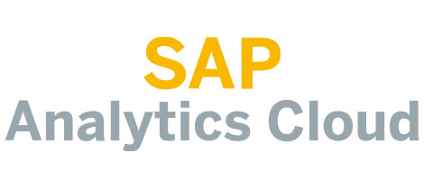
























SAP Analytics Migrations
People Analytics
Global Spend
Sales
Finance
Industry
Real Estate
Pharma
+70 references
Migración ETL Facturación
Integración IBM Maximo
Migración Modelo Compras
Migración Modelo Financiero
Migración BW e Informes SAC
Análisis Finanzas y Ventas
Información de Ventas
Réplica modelo BW
Migración Modelos Legal, Estructura, Operacional y Consolidación
Implementación dataflow compras e Informes SAC
+15 references
Nueva plataforma analítica
Migración modelos BW
Modelos analíticos con SAC
Nuevos modelos analíticos sobre S4
Gestión empresarial en BW/4HANA 2.0.
Proyecto de gestión financiera en BW/4HANA 2.0
Proyecto de consolidación en BW/4HANA 2.0
Proyecto de análisis de riesgos en BW/4HANA 2.0
BW/4HANA Migration
+15 references
Remodelado de la capa de extracción y adaptación del modelo a LSA++ en BW/4HANA 2.0
Laboratorio para establecer una visión estratégica de gestión de la información con BW4HANA
Proyecto de gestión logística en BW/4HANA 2.0
Despliegue de HANA como el DataWarehouse corporativo
Soporte en proceso presupuestario en BW IP
Evolutivos y soportes corporativos
Soporte y evolutivos corporativos
Soportes y evolutivos
+150 references
Reporting ventas, ofertas y cuenta de resultados
Cuadros de Mando para GNL, RRHH, IT, Compras y Finanzas.
Presupuestación, consolidación y seguimiento presupuestario
Upgrades to BO 4.3
and SAC migrations
Reporting e Indicadores Estratégicos para Dirección
Planificación de Recursos de Ingeniería
Diseño de Cuadro de Mando de RRHH (HCM DATAMART)

Slide 73
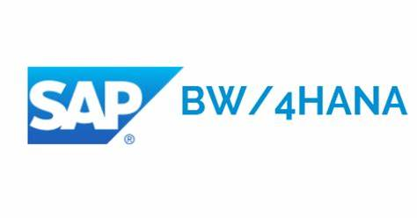








SAP Analytics Migrations
Migration project to BW/4HANA 2.0 in Greenfield mode.
Migration from BO 4.1 to BO 4.3
Migration project to BW/4HANA 2.0 from a BW 7.3 using Remote Conversion
Migration from BO 4.1 to BO 4.3
Upgrade from BW/4HANA 1.0 to BW/4HANA 2.0
Migration from BO 4.1 to BO 4.2
Migration to BW/4HANA 2.0 from a BW 7.5 using Shell Conversion.
Migration from BO 4.1 to BO 4.3
.
Migrating from BW 7.0 to BW4/HANA 1.0 using In-Place Conversion
Migrating from BW 7.0 to BW4/HANA 1.0 using Remote Conversion
73

Slide 74





Global Spend
GLOBAL SPEND
The end-to-end analysis of expenses based on advanced analytics, predictive and machine learning around 5 fundamental business axes allows designing a Data Driven strategy to improve the company's decision-making process.
Procurement insights
It allows you to measure and analyze the main purchasing processes (Sourcing, Invoicing, contract and operations management)
SAP Ariba & S4HANA
Procure to order
Sourcing
Invoicing
Contract Management
Buying
Catalogue
Suppliers
SAP Ariba & S4HANA
SLP - 360º Supplier Analysis to track volume, quality and certifications by product and service Supplier Risk - Sentiment Analysis
Personnel Costs
SAP SuccessFactos & SAP Fieldglass
Employee costs External Services Analysis and Outsourcing
Streamline workforce management with integrated visualization of total personnel costs (payroll, training, social security,..).
Expense Planning
Planning of purchases of goods and services of the company, allowing planning both centralized purchases and decentralized purchases by department Personnel cost planning
Improves process agility by unifying tasks of preparation, elaboration and analysis and monitoring of the planning process
Travel Expenses
SAP Concur
Comprehensive view of employee travel spend control

Slide 75

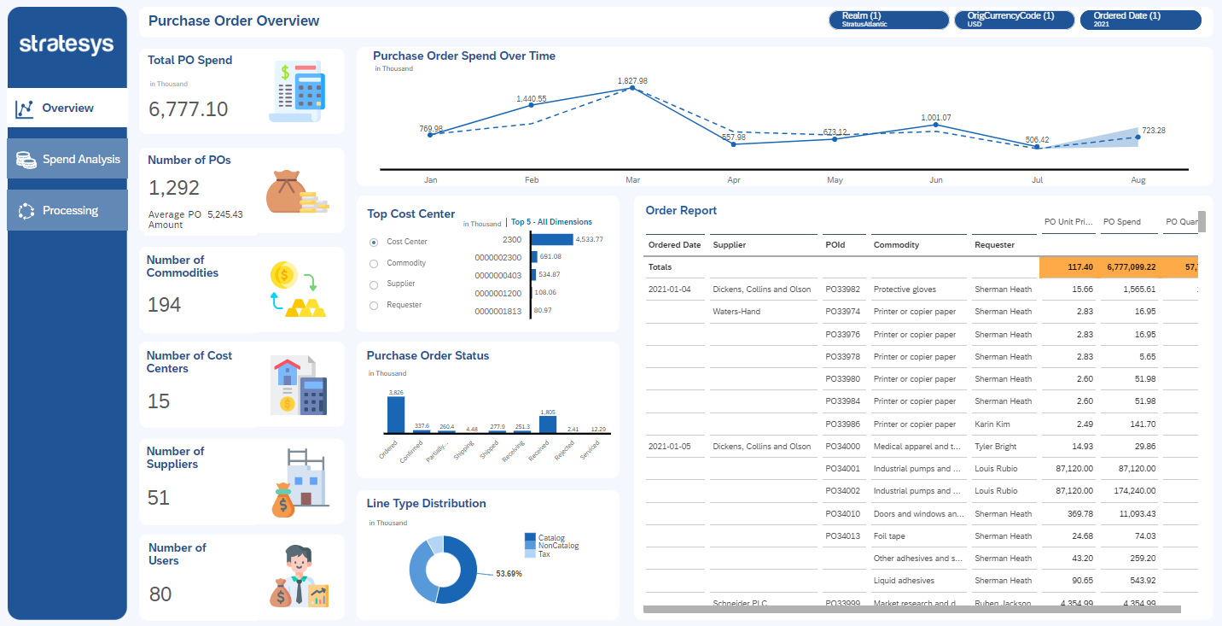

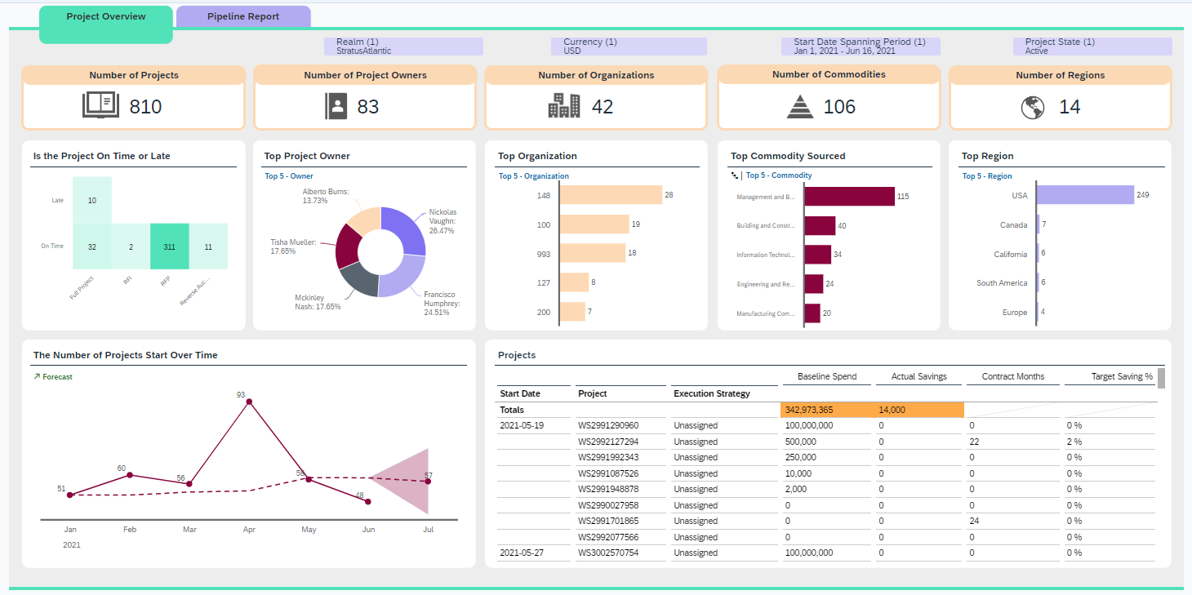

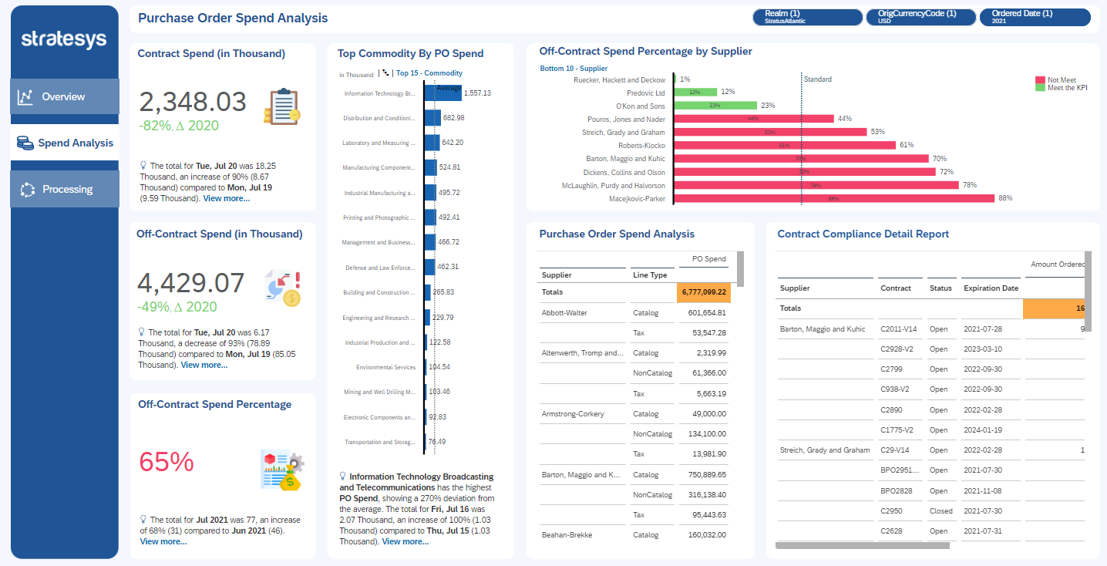


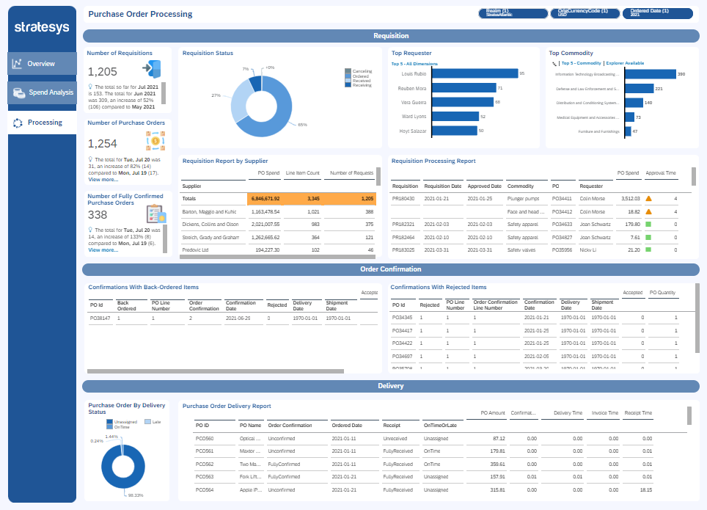
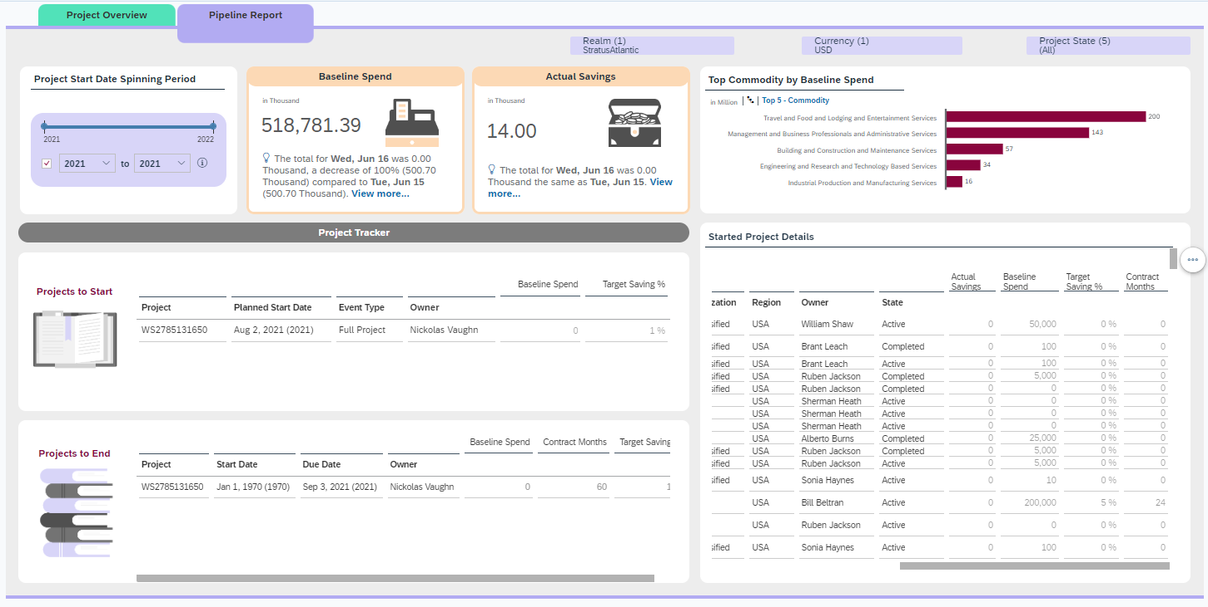


Global Spend – Accelerators - Procurement Insights (Ariba)
GLOBAL SPEND – PROCUREMENT INSIGHTS (ARIBA)
Procure to Order
Analysis of the company's expenses and savings. The evolution of expenditure is studied, according to the type of expenditure, the cost centre and the supplier.
Sourcing Project
Global analysis of supply projects and their monitoring.
Contract Management
Analysis of the company's contract and supplier management.
Invoicing
Detail of invoices according to status, type of exception and days in pending status.
Buying
Study of the purchases made and each of the stages of a purchase.

Slide 76
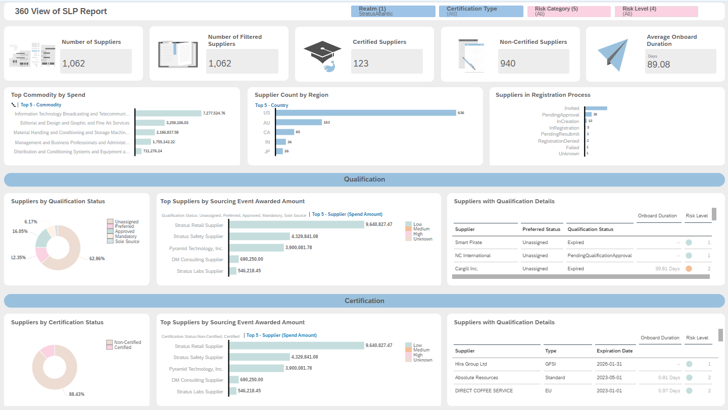
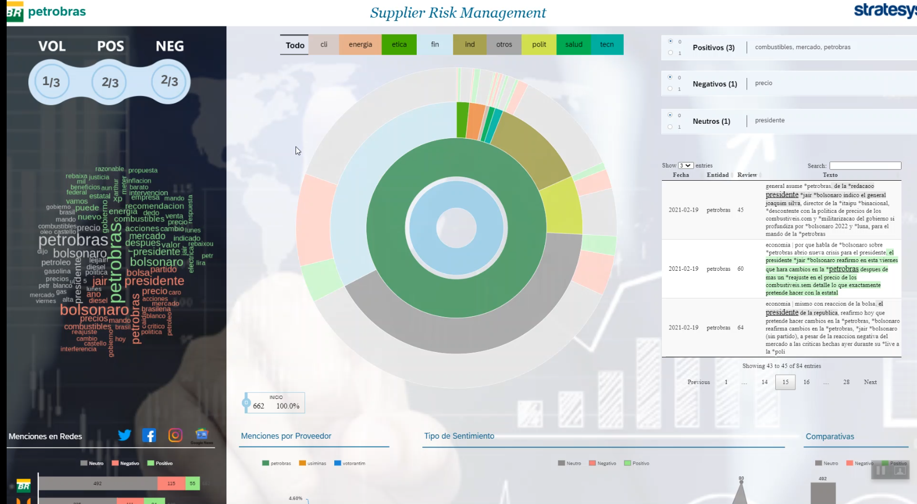

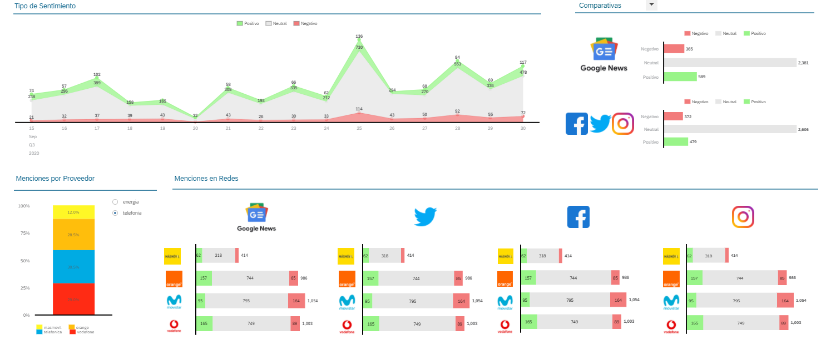

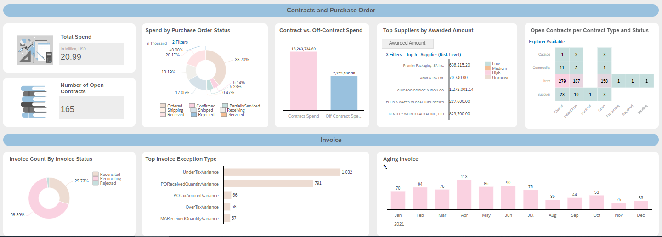
Global Spend – Accelerators - Suppliers
SUPPLIERS
360 View of SLP Report
360º analysis of suppliers from their qualification and certification to contract management.
Supplier Risk Management
Social media data and news about supplier risk using AI.

Slide 77
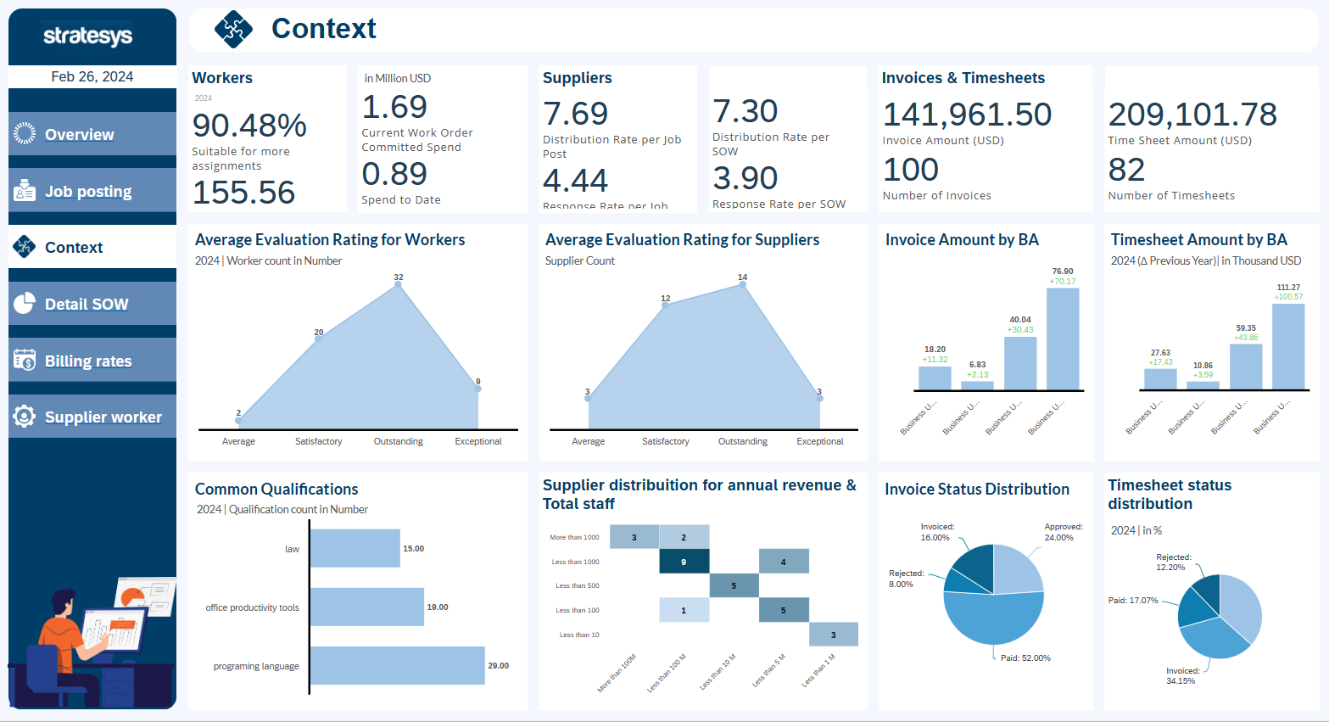
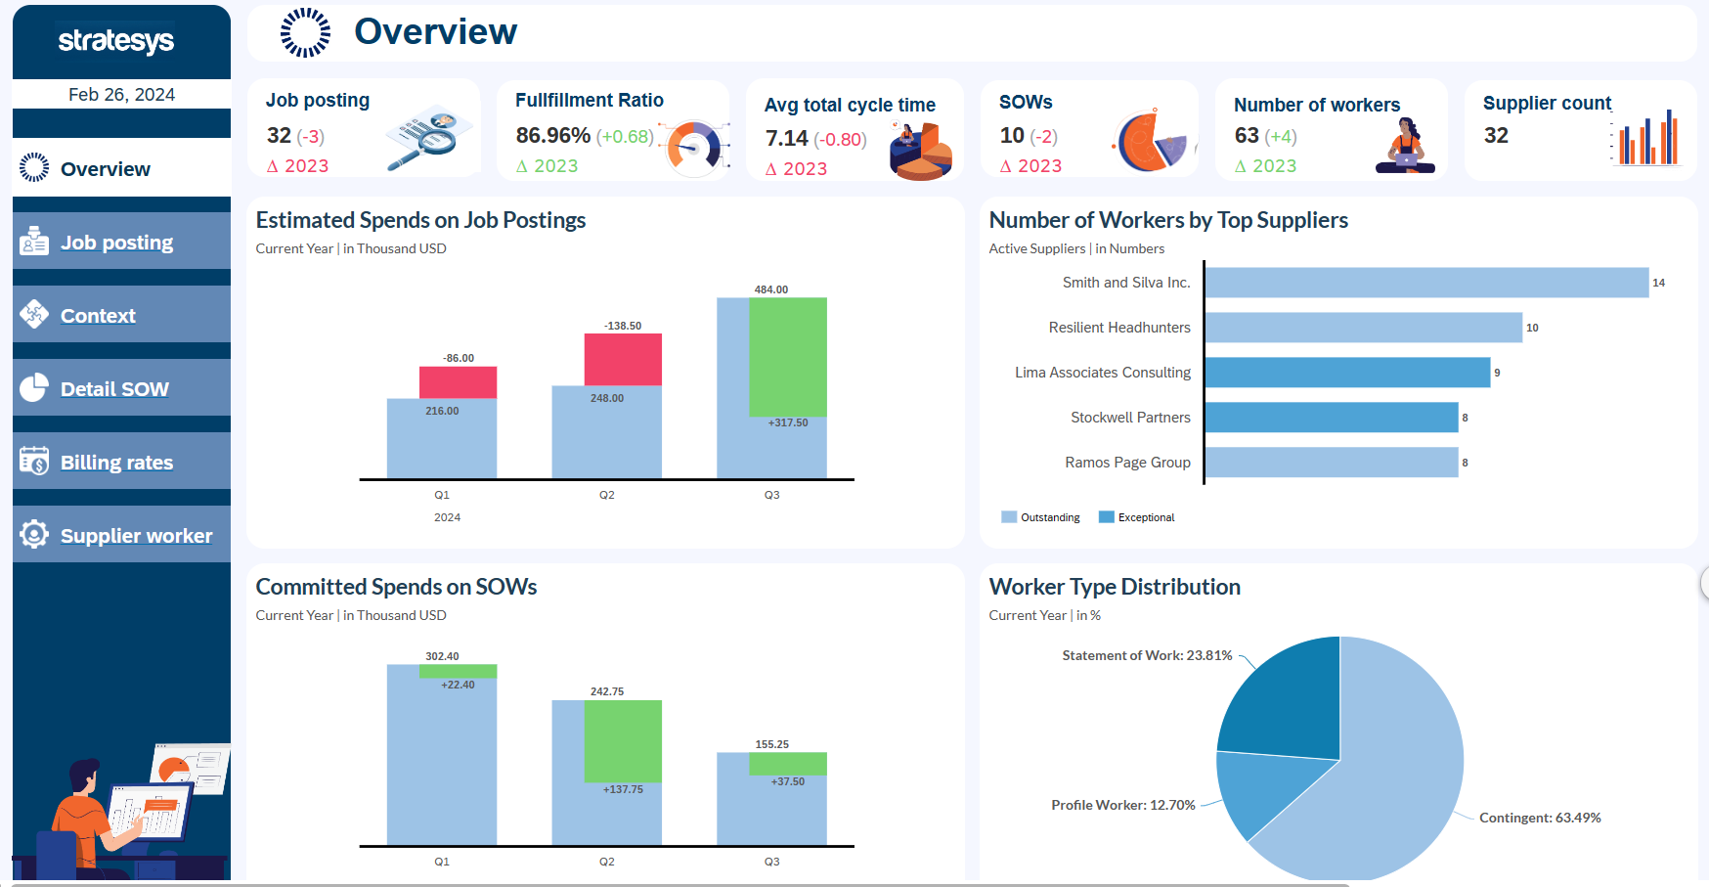


Global Spend – Accelerators – Personnel Costs (Fieldglass)
GLOBAL SPEND – PERSONAL COSTS (FIELDGLASS)
External Personnel Management
PERSONNEL COSTS
Information on the current situation of contingent and declaration of work (SOW) workers in your company, analyze costs and supplier relationships.
Contingent Workforce Analysis and SOW Analyze how many contingent workers and SOWs are currently hired.
Control spending by comparing current costs with those of the previous year, drill down by country or business area. Analyze billing rates and compare them to your HR expenses.
Cycle times and flexibility in contracting Hire cycle times to understand how flexibly your company can react to workforce-related changes.
What qualifications are available, how quickly suppliers respond, and how good the level of qualification is. How many of the workers are eligible for rehiring?
Supplier analysis Overview of how many suppliers your company is currently working on, how many workers they sent, supplier qualifications and expenses per supplier.

Slide 78





Global Spend – Accelerators – Travel Expenses (Concur)
GLOBAL SPEND – TRAVEL EXPENSES (CONCUR)
Travel and Expense Management
TRAVEL EXPENSES
Analysis of the overall situation of travel expenses, showing expenses by category, period, country, city and comparison with the Previous Period.
Travel Expenses
Distribution of travel expenses by Supplier, Period, Payment Method and Category.
Reports
Distribution of trip reports focusing on the amount claimed and approved for each employee in addition to the approval status of the trip report.
Detail Records
Detailed report of all trips by records, type of expense, supplier, country, location and date.
Approval of Expenses
Detailed analysis of the expense approval process, highlighting the time between each phase of the process and its evolution over time.

Slide 79










Global Spend – References
GLOBAL SPEND – REFERENCIAS
Purchasing, savings and time
Purchasing-Stock-Sales
Order flow for Invoices, Deliveries
Purchases, expenses and investments
Analysis of purchases of products and services, by supplier Identification of order savings and visualization of purchasing process times. Data from S4HANA.
Relationship of the purchase flow and comparison with Stock and sales of pharmaceutical products. Data from BW4HANA.
Visualization of the relationship of the flow of orders, invoices and deliveries. Display of amounts and status by vendors and item groups. SAP HANA ERP Data
Analysis of purchases, expenses and investments associated with equipment projects and maintenance. S4HANA and Ariba Information
RFP Smart Map Comparison
Purchase operations
Concur Travel Expenses
ECI Travel Expenses
Comparative analysis of suppliers by RFP. Display of the prices offered, quantities and discounts with respect to the RFP price with Ariba data.
View the operations purchases and sales relationship for each project ID with S4HANA data
Analysis of travel expenses, visualization and travel flows by volume of economic amount. Data from SAP Concur
Detailed analysis of employee travel expenses with information from Viajes ElCorteInglés.

Slide 80





Global Spend – SAP Ariba Data Integration
CONNECTIVITY: 100% SAP solution for SAP Ariba data extraction
BEST PRACTICES: SAP-recommended data flow
DATA SOURCE
CONNECTOR
DATA MODEL
VISUALIZATION

